Slide 1
Final Report for Capstone Project
Date-24-07-2022
Group 11 Jul 21A NLP Project 2:
Submitted By:-
1. Bhavadharini Parthasarathy
2. Keerthana V Elango
3. Surajit Pal
4. Vaibhavi Gujar
5. Prajual Gupta
6. Prachi Sangram Pawar
NLP based Chatbot on Industrial Safety.

Slide 2
Domain: NLP based Chatbot on Industrial Safety.
Context: The database comes from one of the biggest industry in Brazil and in the world. It is an urgent need for industries/companies around the globe to understand why employees still suffer some injuries/accidents in plants. Sometimes they also die in such environment.
DATA DESCRIPTION: This The database is basically records of accidents from 12 different plants in 03 different countries which every line in the data is an occurrence of an accident.
Columns description:
‣ Data: timestamp or time/date information
‣ Countries: which country the accident occurred (anonymised)
‣ Local: the city where the manufacturing plant is located (anonymised)
‣ Industry sector: which sector the plant belongs to
‣ Accident level: from I to VI, it registers how severe was the accident (I means not severe but VI means very severe)
‣ Potential Accident Level: Depending on the Accident Level, the database also registers how severe the accident could have been (due to other factors involved in the accident)
‣ Gender: if the person is male of female
‣ Employee or Third Party: if the injured person is an employee or a third party
‣ Critical Risk: some description of the risk involved in the accident
‣ Description: Detailed description of how the accident happened.

Slide 3
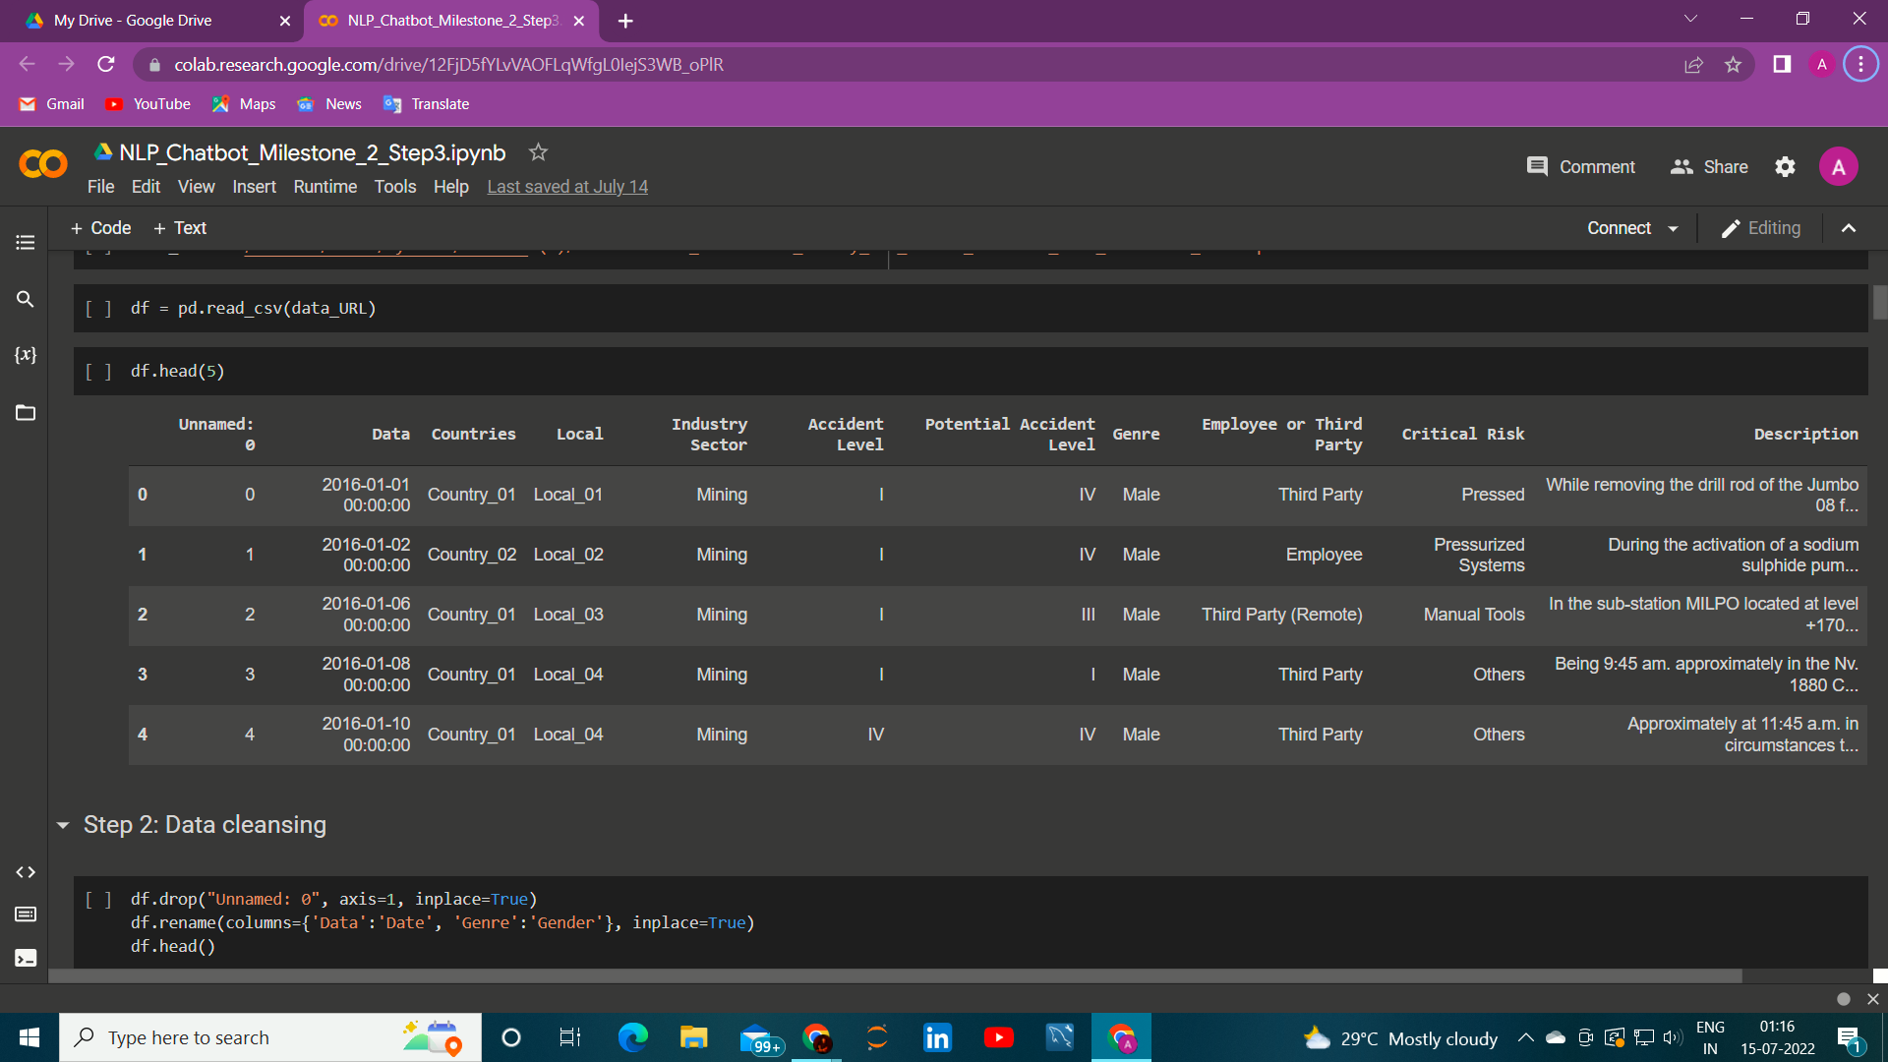
Load And Import Data:
Data Cleansing Summary:
We are left with 418 rows and 10 columns after data cleansing.
Label Encoding Changing the Column Accident level And Potential Accident level to countable as they were in roman numbers .
Removed 'Unnamed: 0' column and renamed - 'Data', 'Countries', 'Genre', 'Employee or Third Party’ and ‘Accident Level’ columns in the dataset.
We had 7 duplicate instances in the dataset and dropped those duplicates.
There are no outliers in the dataset.
No missing values in dataset.

Slide 4
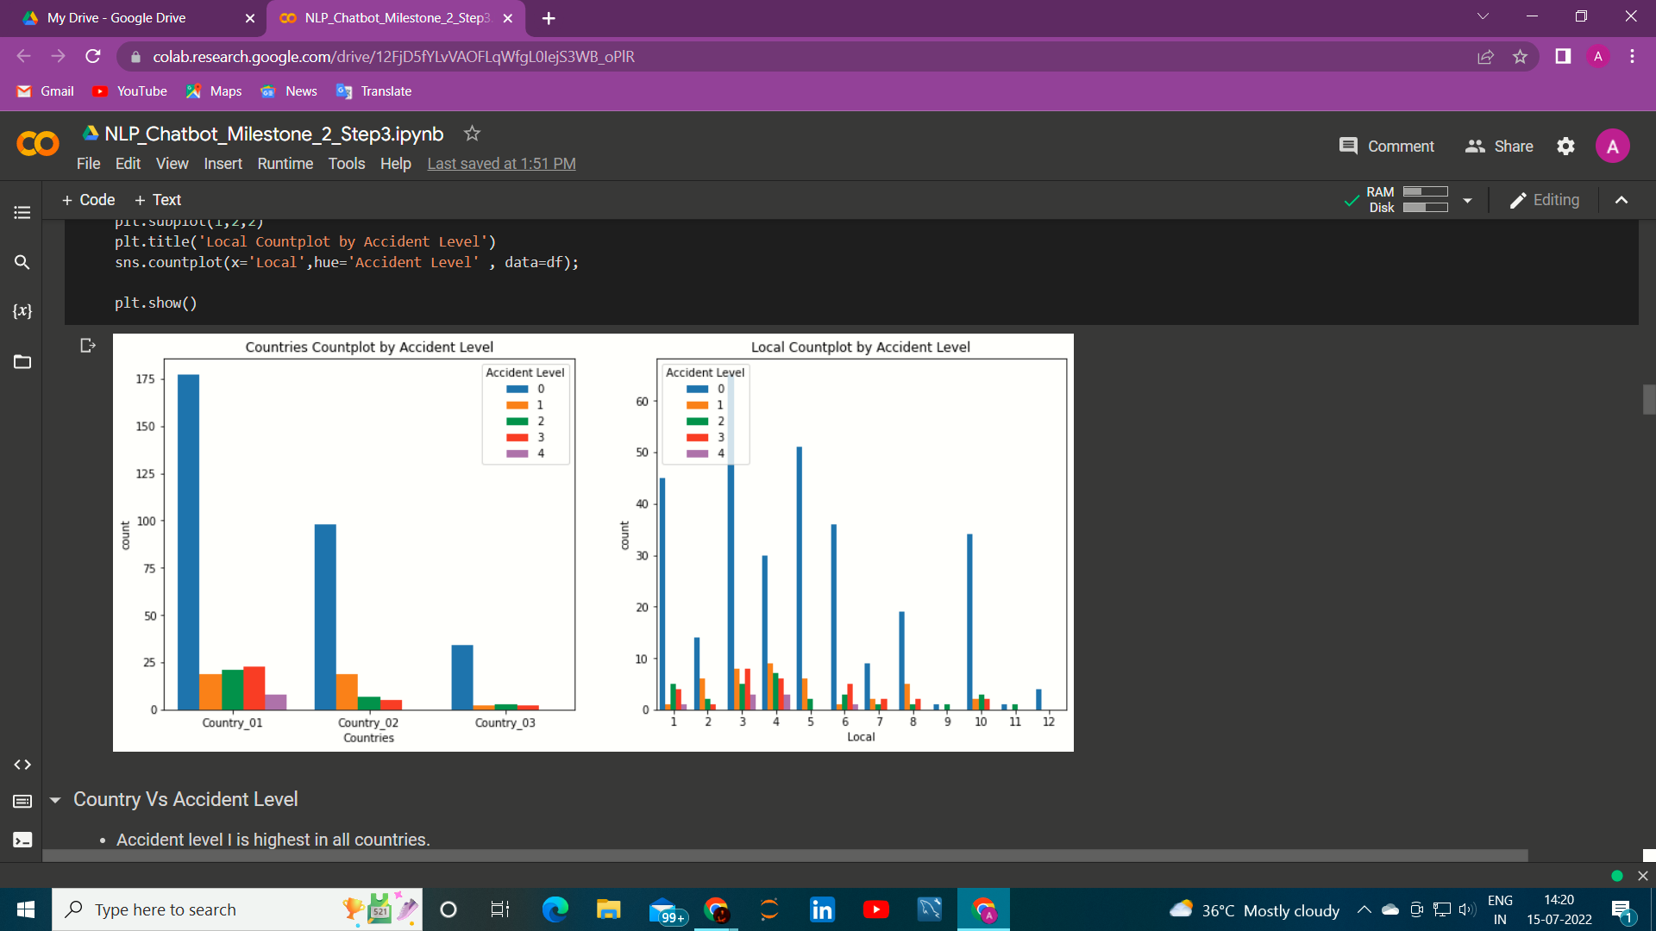
EDA Data Analysis And Visualization Summary:
Univariate Analysis Observation :
The most affected country from the above dataset is country_01 with around 59% of the accidents with the count of 250.
Most accidents happened in Local_03 .Its count is 90 ,which is equivalent to 21.18%. The second Most Accident happens in local_5 which is equivalent to 13.88%.
Mostly affected sector is Mining sector. 56.71% of accidents occur in Mining sector.
Most affected workers in accidents are male .Their count is 403 ,which is equivalent to 94.82%.
Most accidents belongs to "Accident Level - I" .Its count is 316 which is equivalent to 74.35%% of total accidents.
Most "Potential Accident Level" belongs to level IV .Its count is 143 which is equivalent to 33.65% of total potential accidents.
Most affected Employee type are Third party workers .Their count is 189 ,which is equivalent to 44.47%.
Most accidents happen in year 2016.Count is 285 ,which is equivalent to 67.06% .
Most accidents happen in Feb month.Count is 61 ,which is equivalent to 14.35%.
Bivariate Analysis Observation:
Country Vs Accident Level
Accident level I is highest in all countries.
Most accidents happened in Country_01.
Accident level in Country_03 is lesser than other countries.

Slide 5
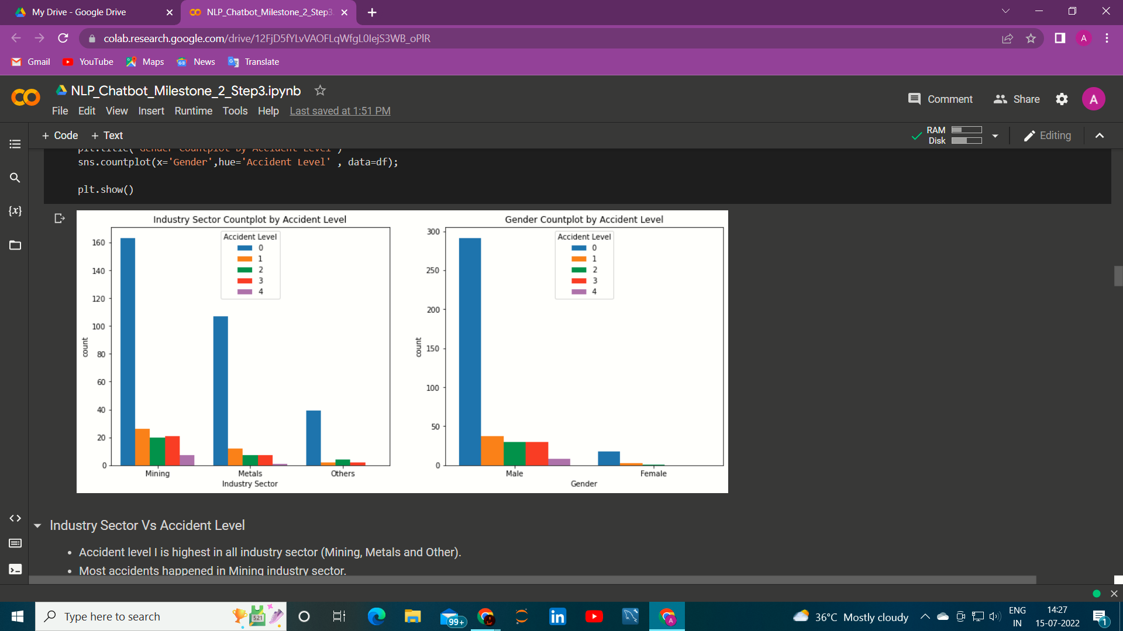
Local Vs Accident Level
Accident level I is highest in almost all localities.
Accident level I is highest in Local 3.
Local 9,11 and 12 have less accidents level.
Industry Sector Vs Accident Level
Accident level I is highest in all industry sector (Mining, Metals and Other).
Most accidents happened in Mining industry sector.
After Accident Level I ,Level II is Highest among all the Industries.
There are very few cases for Accident level 5.
Gender Vs Accident Level
Accident level I is highest among the Gender.
Most accidents happened with male ones.
There are very few cases With Females.

Slide 6
DATA PRE- PROCESSING
Lower Case : : Converting a word to lowercase. THe scaling of words will get easy. Its is pre processing technique
Remove Punctuation: An important NLP preprocessing step is punctuation marks removal, this marks - used to divide text into sentences, paragraphs and phrases - affects the results of any text processing approach, especially what depends on the occurrence frequencies of words and phrases, since the punctuation marks are used frequently .
Remove Stopwords : The words which are generally filtered out before processing a natural language are called stop words. These are actually the most common words in any language (like articles, prepositions, pronouns, conjunctions, etc) and does not add much information to the text.

Slide 7
Lemmatization: Lemmatization is a text normalization technique . Essentially, lemmatization is a technique that switches any kind of a word to its base root mode.
Remove Extra Spaces : Well, removing the extra space is good as it doesn’t store extra memory and even we can see the data clearly.
Tokenization and keeping alphabets : Tokenization is the process of tokenizing or splitting a string, text into a list of tokens. One can think of token as parts like a word is a token in a sentence, and a sentence is a token in a paragraph.
Word CLoud: There are many body-related, employee related, movement-related, equipment-related and accident-related words.

Slide 8
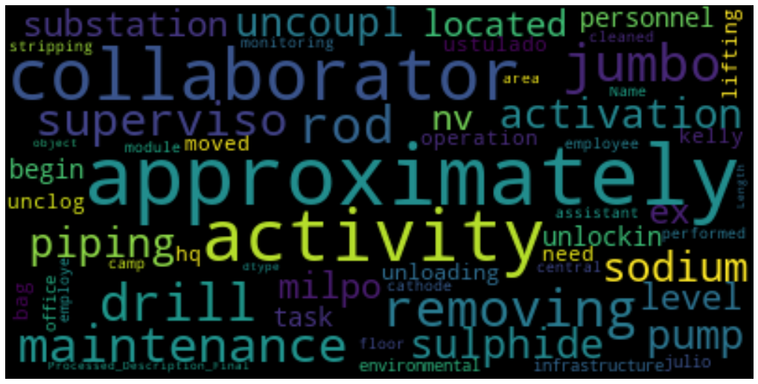
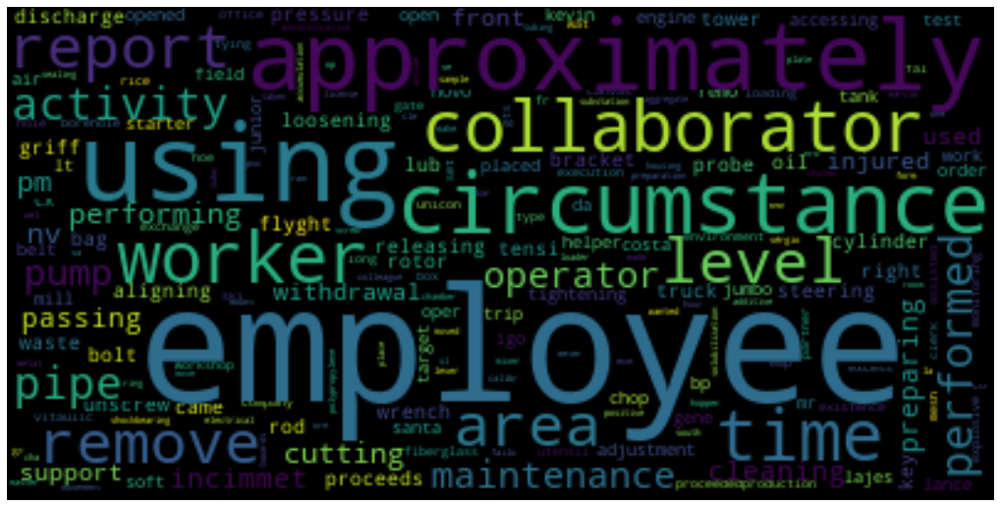
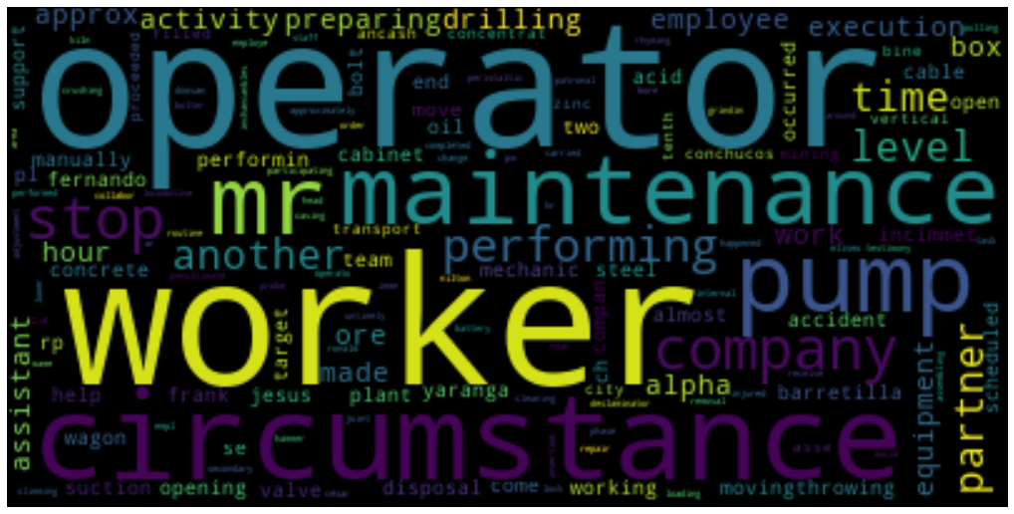
Word CLoud: This is the word Cloud for different Accidental Level.
ACCIDENT LEVEL - 1 ACCIDENT LEVEL - 2
ACCIDENT LEVEL - 3 ACCIDENT LEVEL - 4

Slide 9
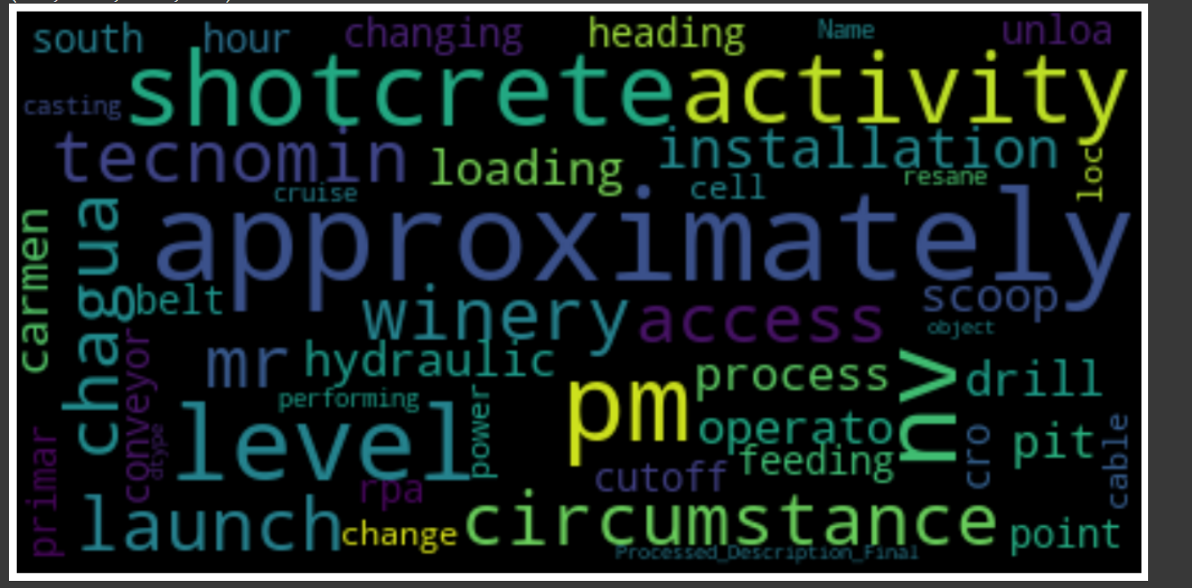
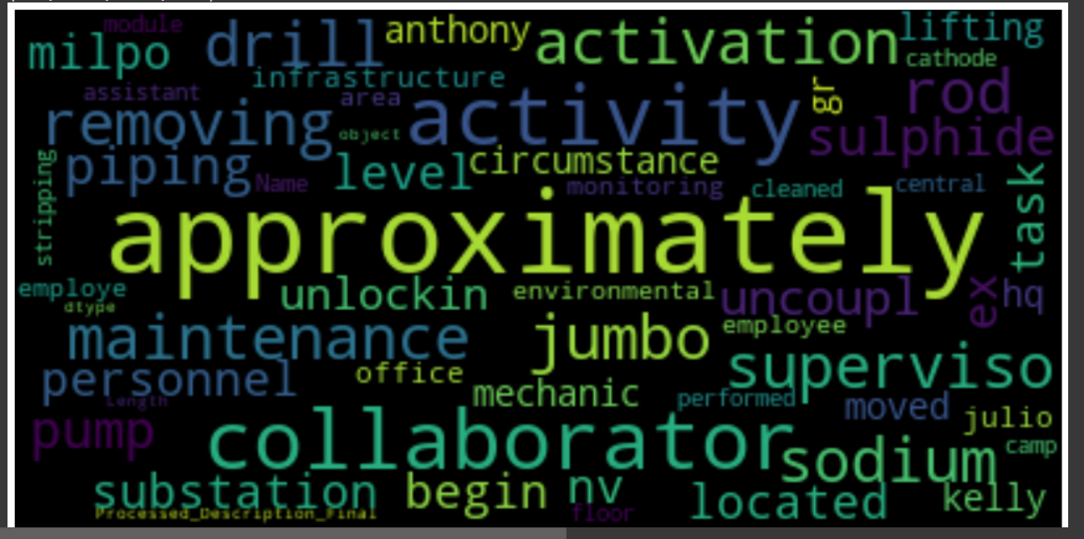
ACCIDENT LEVEL - 5
OVERALL WORD CLOUD

Slide 10
Feature Engineering :
Bag OF words : It shows how many times a word is occurred in the Document.
TF-IDF : which stands for term frequency — inverse document frequency, is a scoring measure widely used in information retrieval (IR) or summarization. TF-IDF is intended to reflect how relevant a term is in a given document.
Word2Vec Embeddings: This tool(Word2Vec) provides an efficient implementation of the continuous bag-of-words and skip-gram architectures for computing vector representations of words. The word2vec tool takes a text corpus as input and produces the word vectors as output. It first constructs a vocabulary from the training text data and then learns vector representation of words. Converting the words back to the sentence form for modelling
Skipgram: Skip-gram is used to predict the context word for a given target word.Converting the words back to the sentence form for modelling
Fasttext: FastText is a library created by the Facebook Research Team for efficient learning of word representations and sentence classification

Slide 11
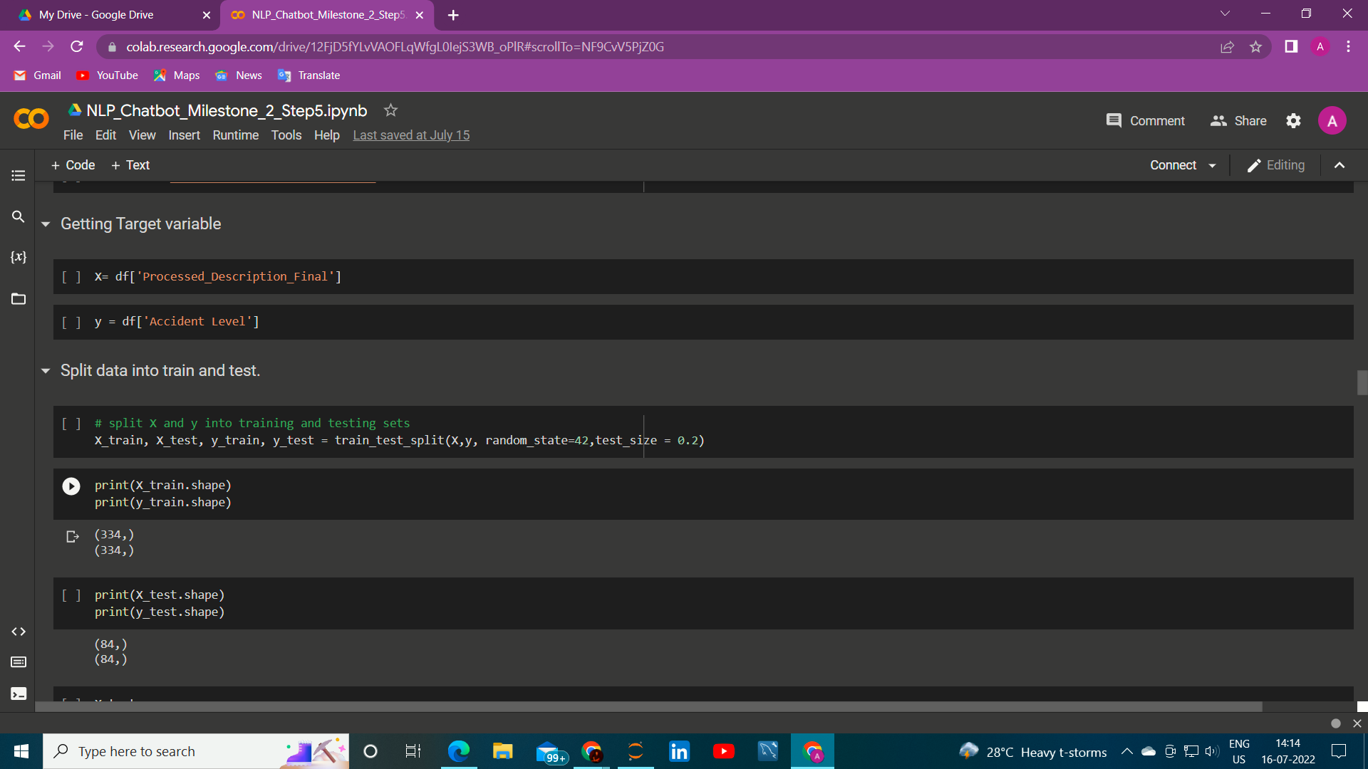
Create Training and Test Set:
Shape of Train Data x_train, y-train =334
Shape of Test Data x_test, y_test =84

Slide 12
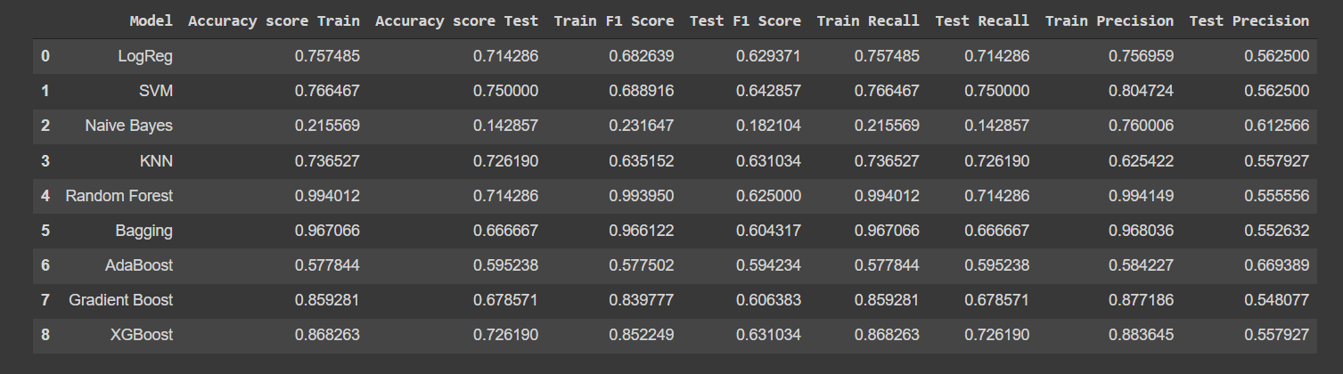
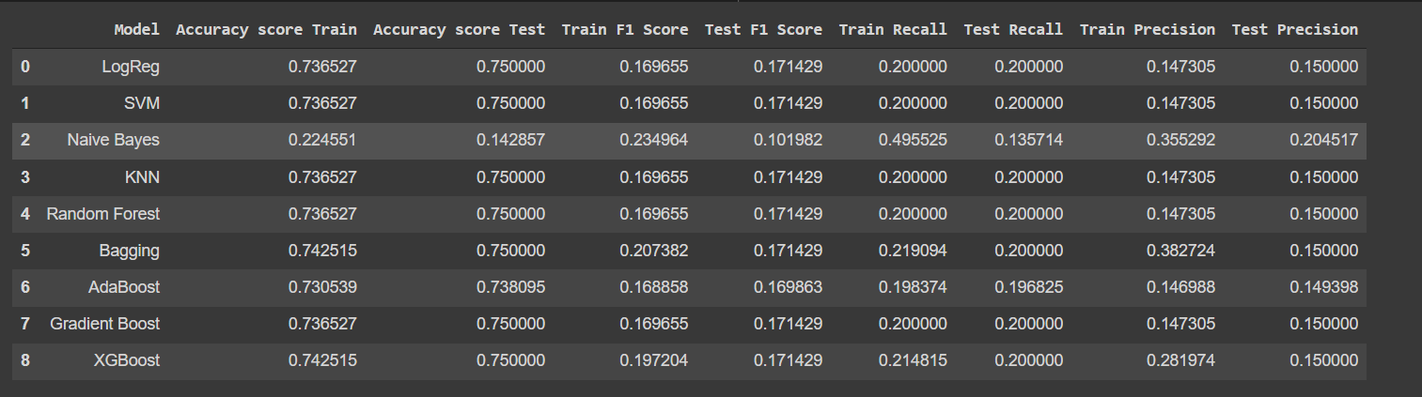
Design, train and test machine learning classifiers
Build classifier Models.
Using BOW Vectorizer :
KNN performs best that all
other models because it is not overfitting
And the Test accuracy increases.
Hyperparameter tuning for BOW
As we can see overfitting is being improved
and still KNN performs Better.

Slide 13
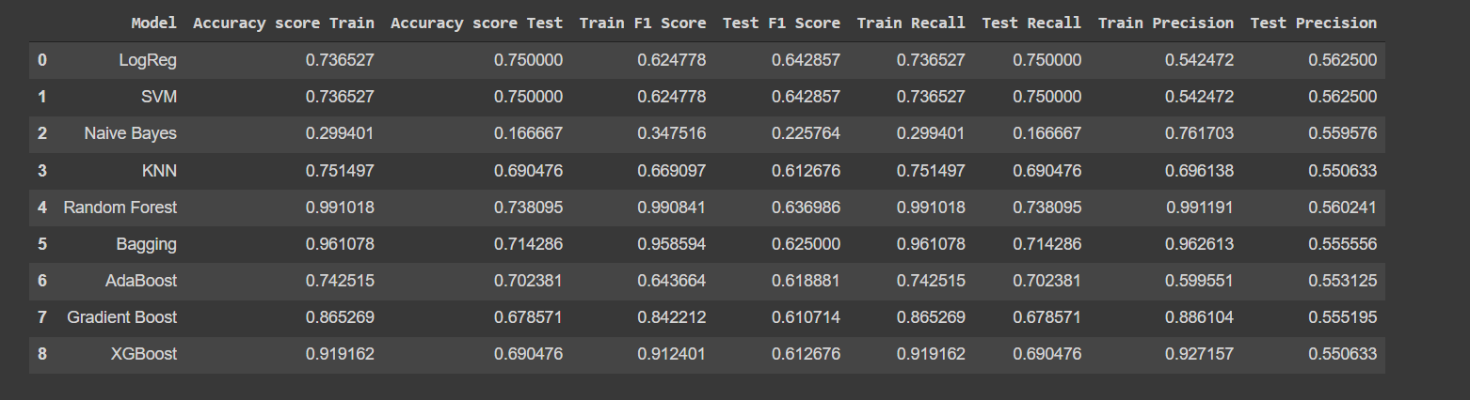
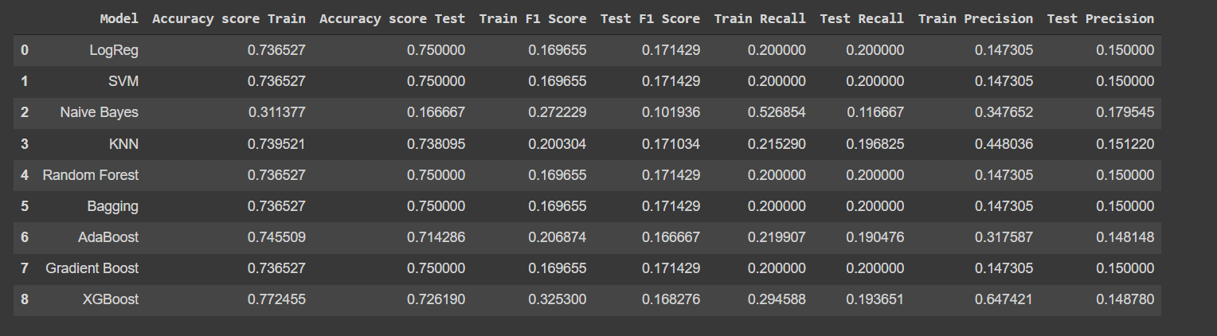
Using TF-IDF Vectorizer:
Logistic regression
and kNN performs better.
Hyperparameter tuning for TF-IDF:
As by doing HyperParameter
tuning we can observe as now
Adaboost accuracy is Convenient.

Slide 14
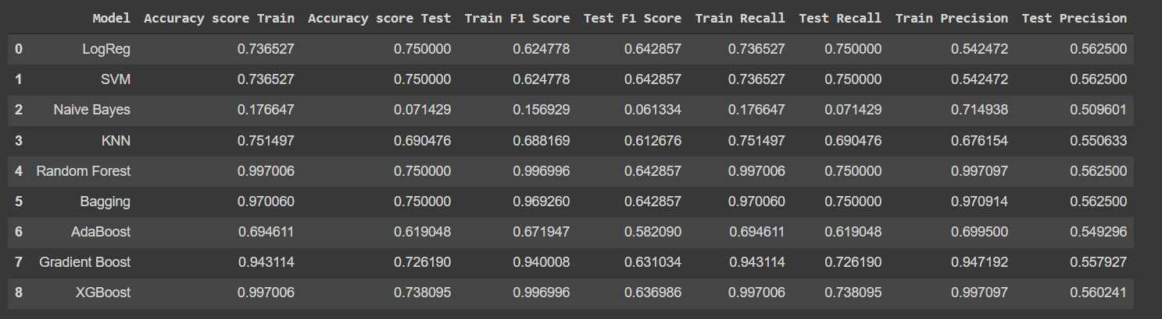
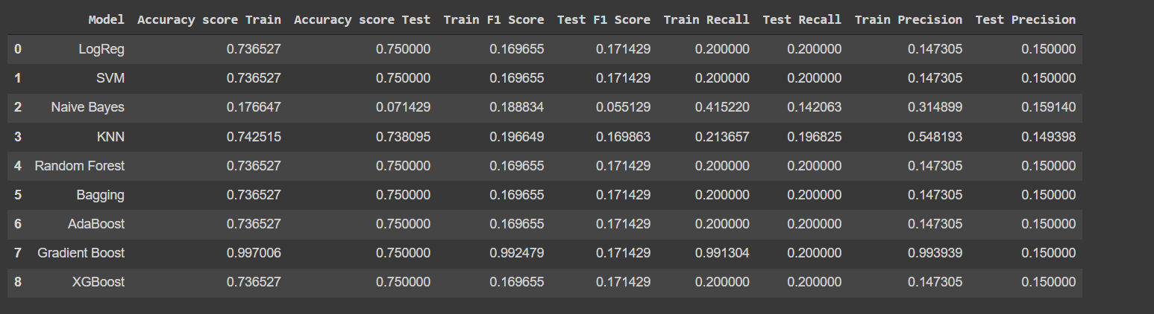
Using CBOW:
In the CBOW model, the distributed
representations of context
(or surrounding words) are combined
to predict the word in the middle .
Logistic regression
and SVM performs better.
Hyperparameter tuning for CBOW:
As by doing HyperParameter
tuning we can observe as
all models except naive bayes
,gradient boost performs well.

Slide 15
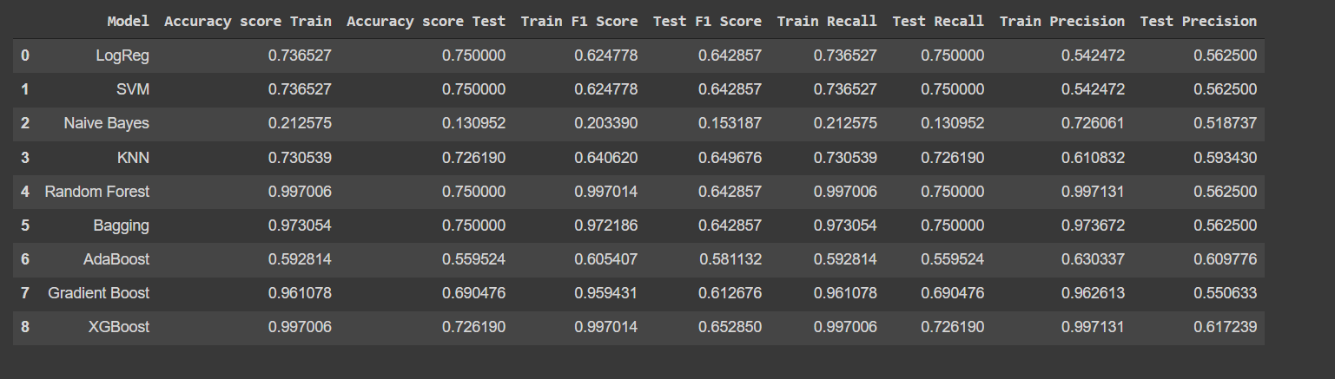
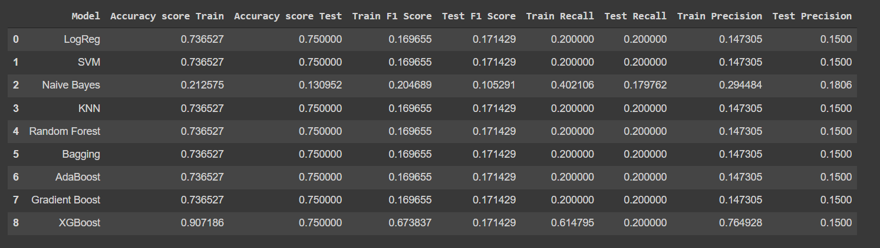
Using Skipgram:
Skip-gram is used to predict the
context word for a given target word. It's reverse
Logistic regression
and kNN, SVM performs better.
Hyperparameter tuning for Word2vec-skipgram:
As by doing HyperParameter
tuning we can observe as
all models except naive bayes
,XG boost performs well.

Slide 16
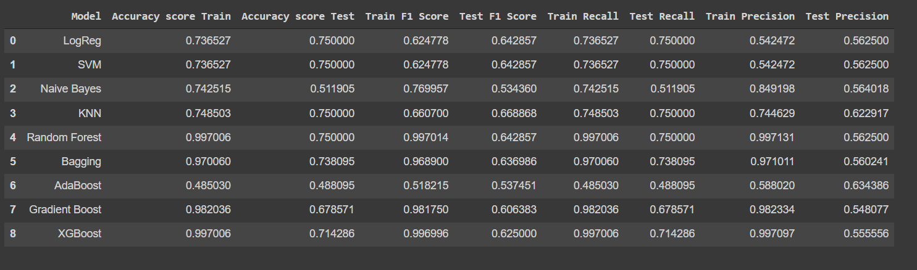
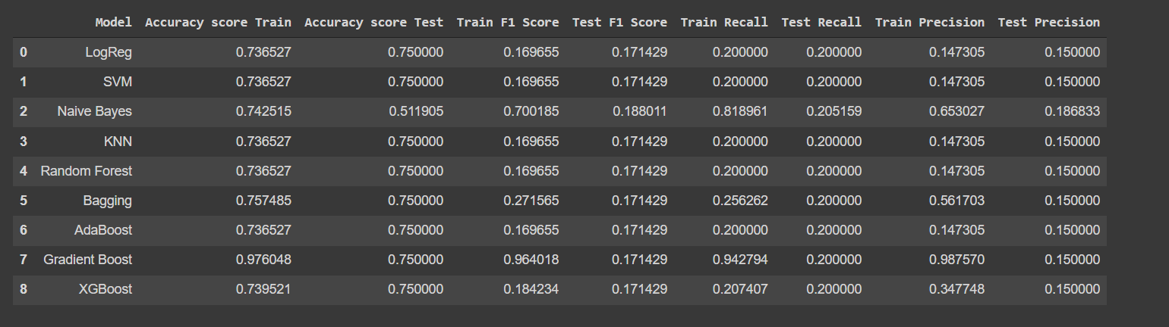
Using Glove :
Logistic regression
and kNN, SVM performs better.
Hyperparameter tuning for Glove:
As by doing HyperParameter
tuning we can observe as
all models except naive bayes
,Gradient boost performs well.

Slide 17
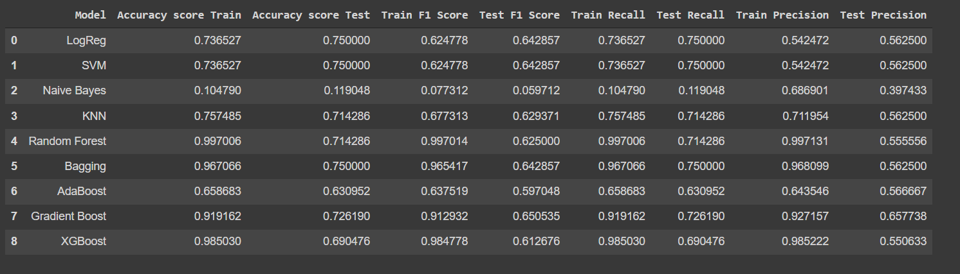
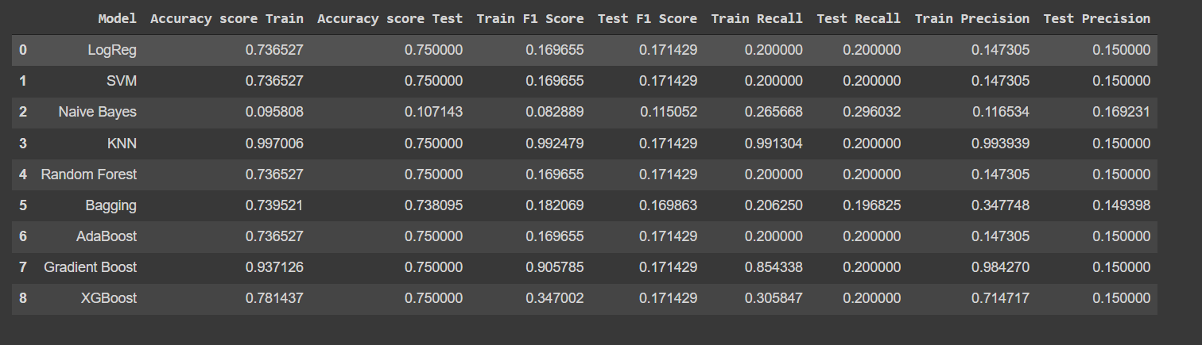
Using Fasttext :
Logistic regression
and kNN, SVM performs better.
Hyperparameter tuning for Fasttext:
As by doing HyperParameter
tuning we can observe as
Log, SVM , Bagging and Random
Forest performs well.

Slide 18
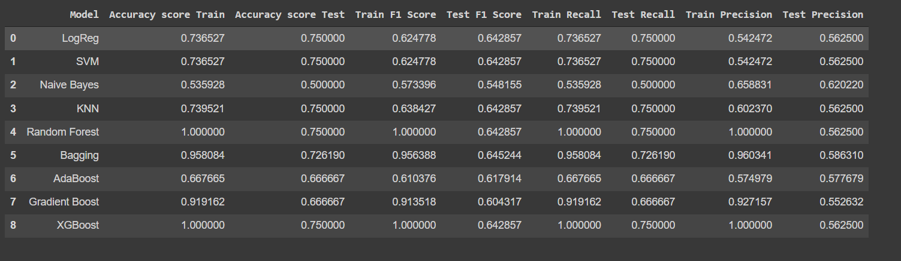
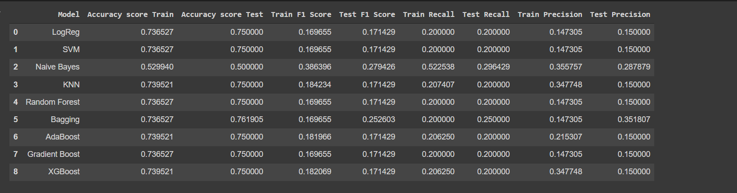
Using Doc2Vec :
Logistic regression
and kNN, SVM performs better.
Hyperparameter tuning for Doc2Vec:
As by doing HyperParameter
tuning we can observe as
All models perform well except
Naive Bayes.

Slide 19
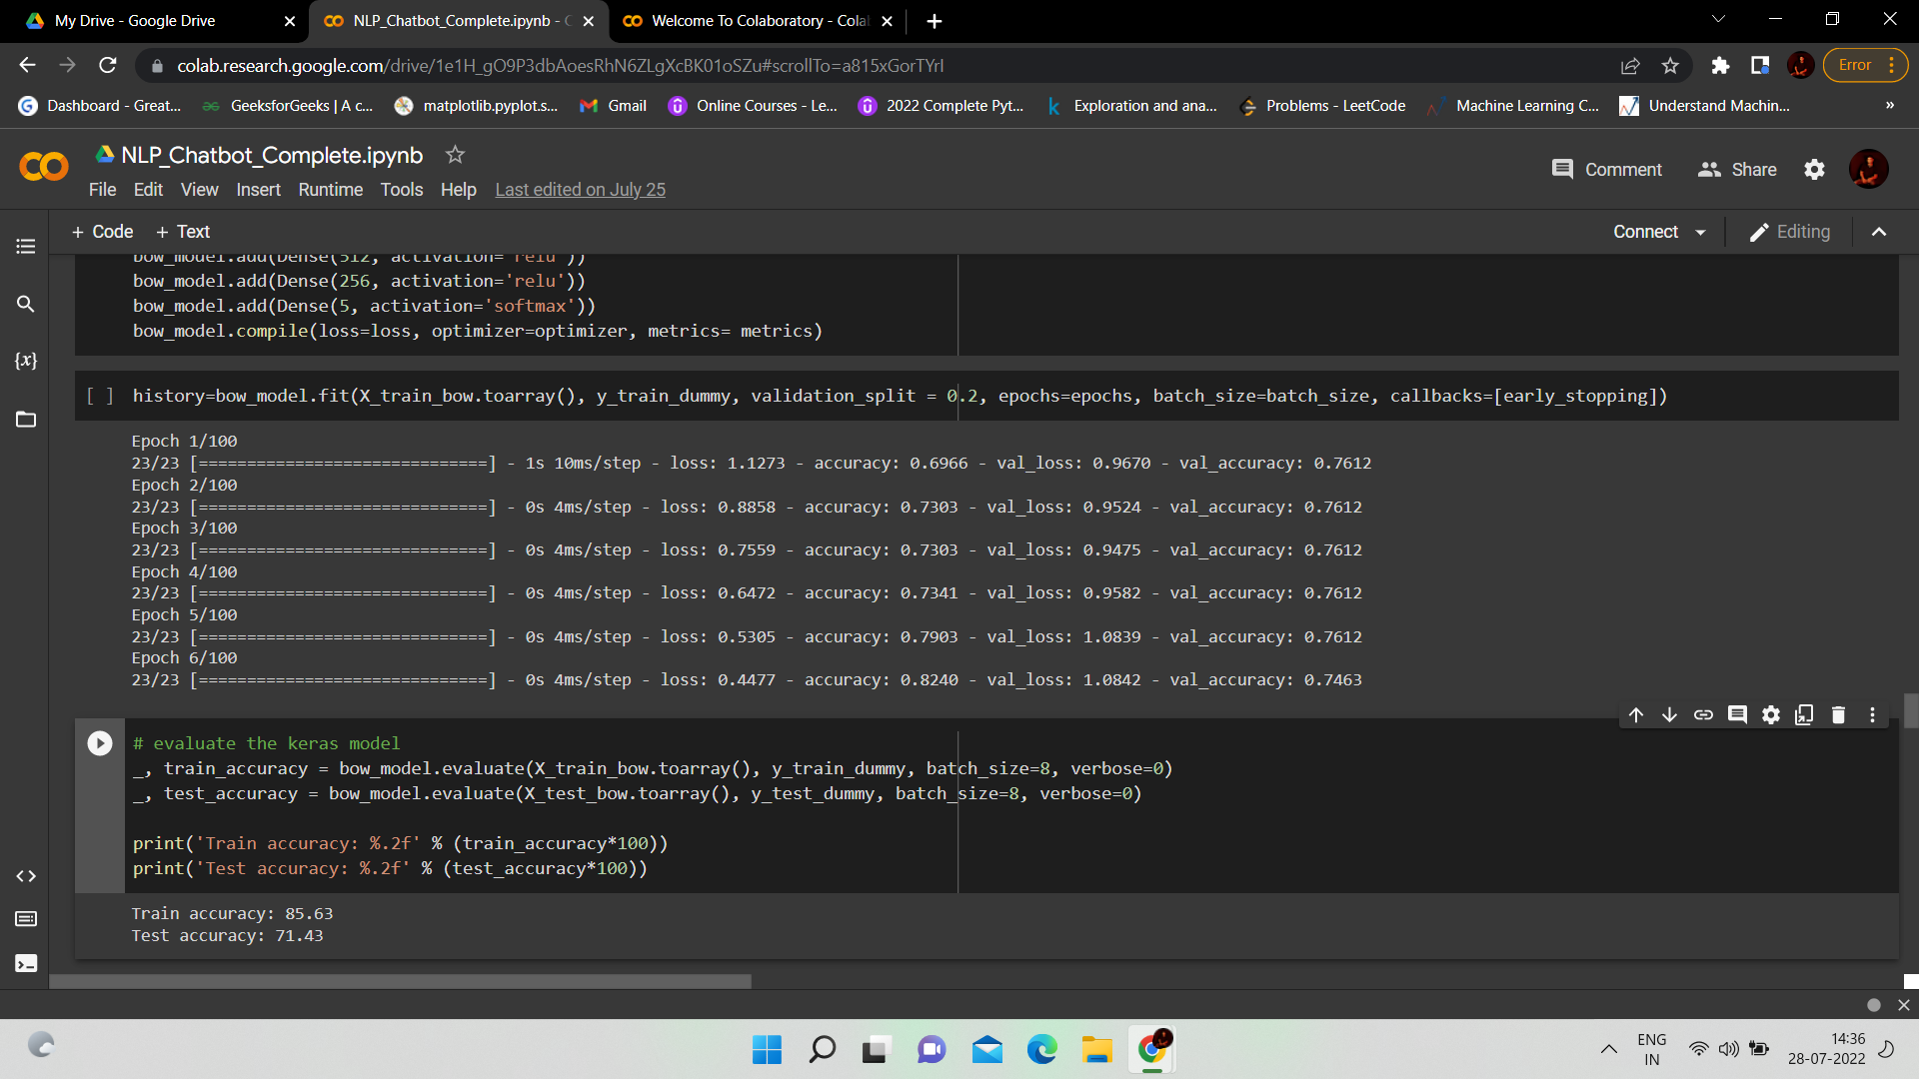
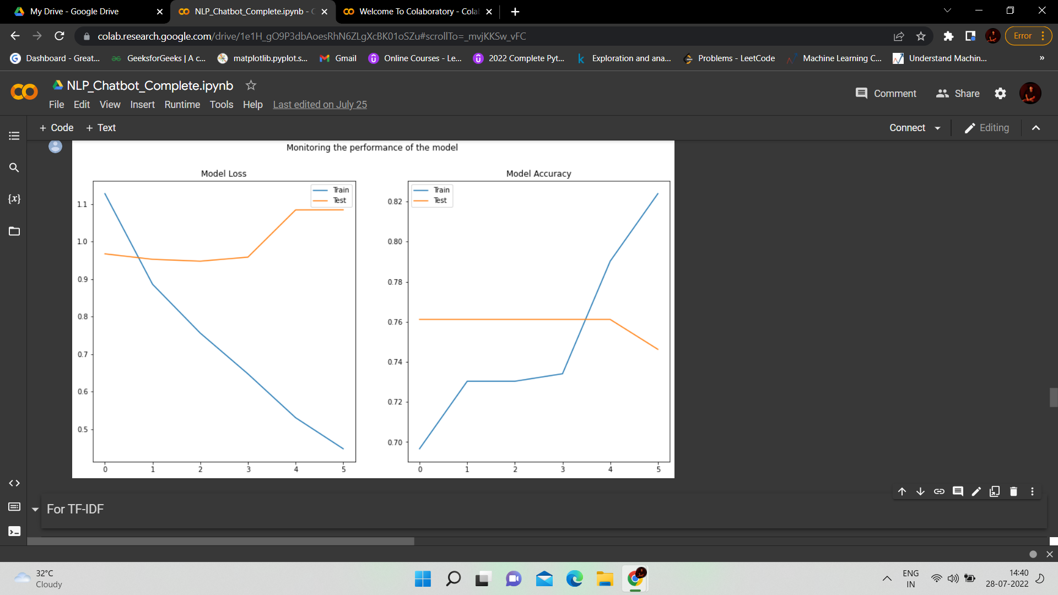
DESIGN AND TRAIN MODEL USING NEURAL NETWORK:
FOR BOW :
For First layer :-Relu Activation
For Second Layer : Relu Activation
For Last Layer : Softmax Activation
Acuuracy Score
Train – 85.63%
Test – 71.43%
Model Loss Model Accuracy

Slide 20
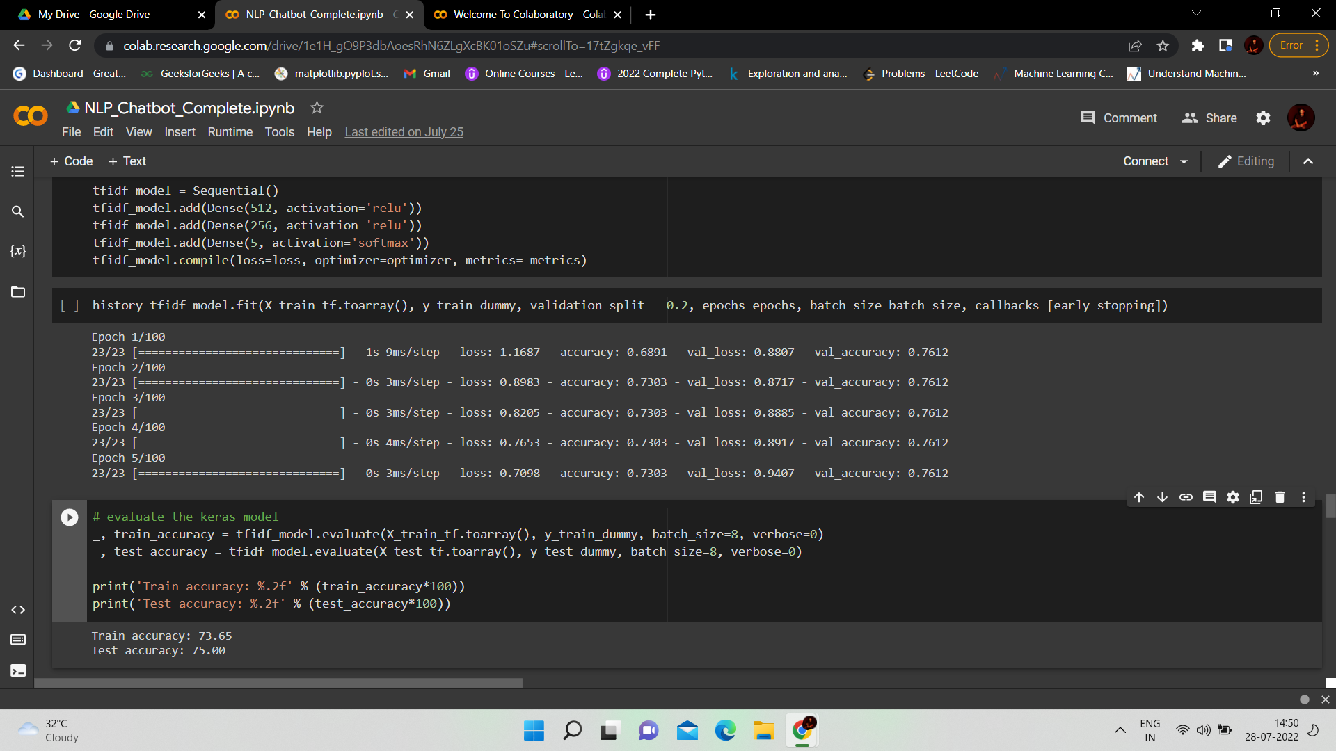
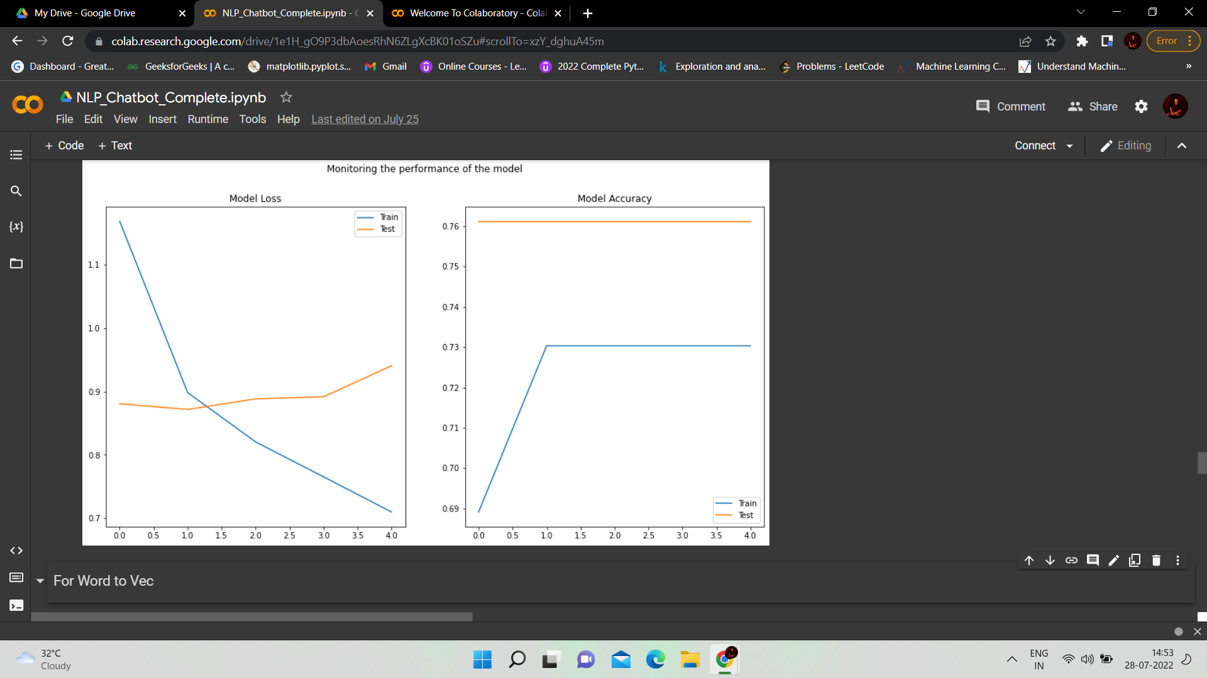
DESIGN AND TRAIN MODEL USING NEURAL NETWORK:
FOR TF -IDF :
For First layer :-Relu Activation
For Second Layer : Relu Activation
For Last Layer : Softmax Activation
Acuuracy Score
Train – 73.65%
Test - 75%
( TF-IDF is better than BOW)
Model Loss Model Accuracy

Slide 21
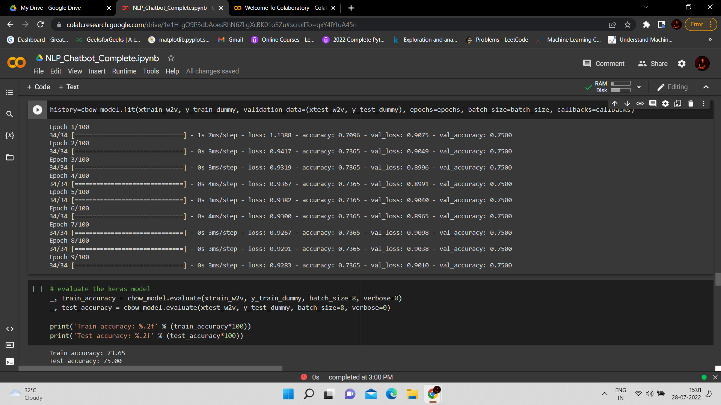
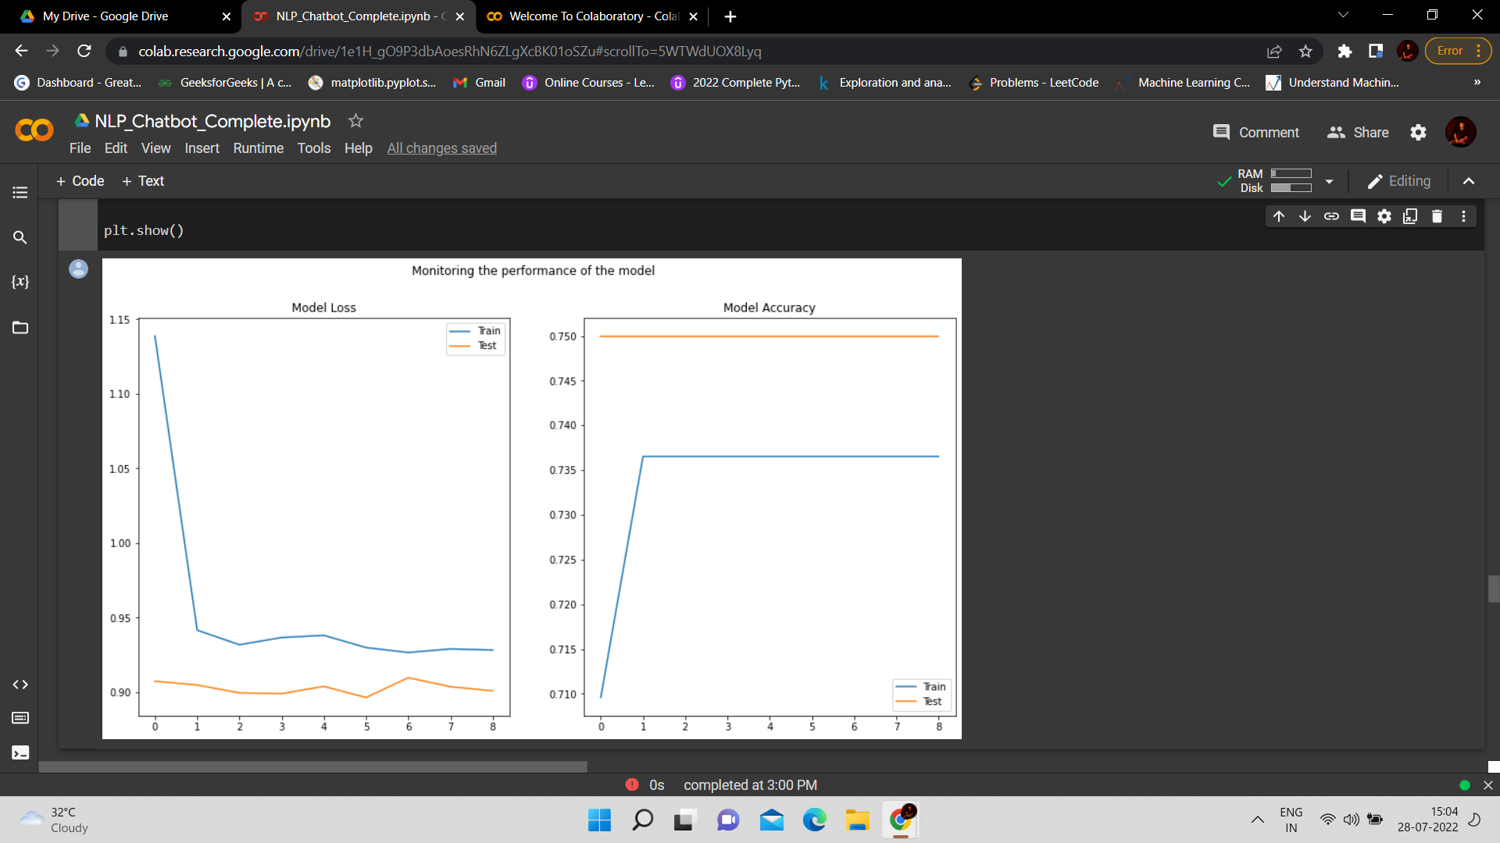
DESIGN AND TRAIN MODEL USING NEURAL NETWORK:
FOR WORD TO VEC :
For First layer :-Relu Activation
For Second Layer : Relu Activation
For Last Layer : Softmax Activation
Accuracy Score
Train – 73.65%
Test - 75%
(Word To VEC is similar to TF-IDF)
Model Loss Model Accuracy

Slide 22
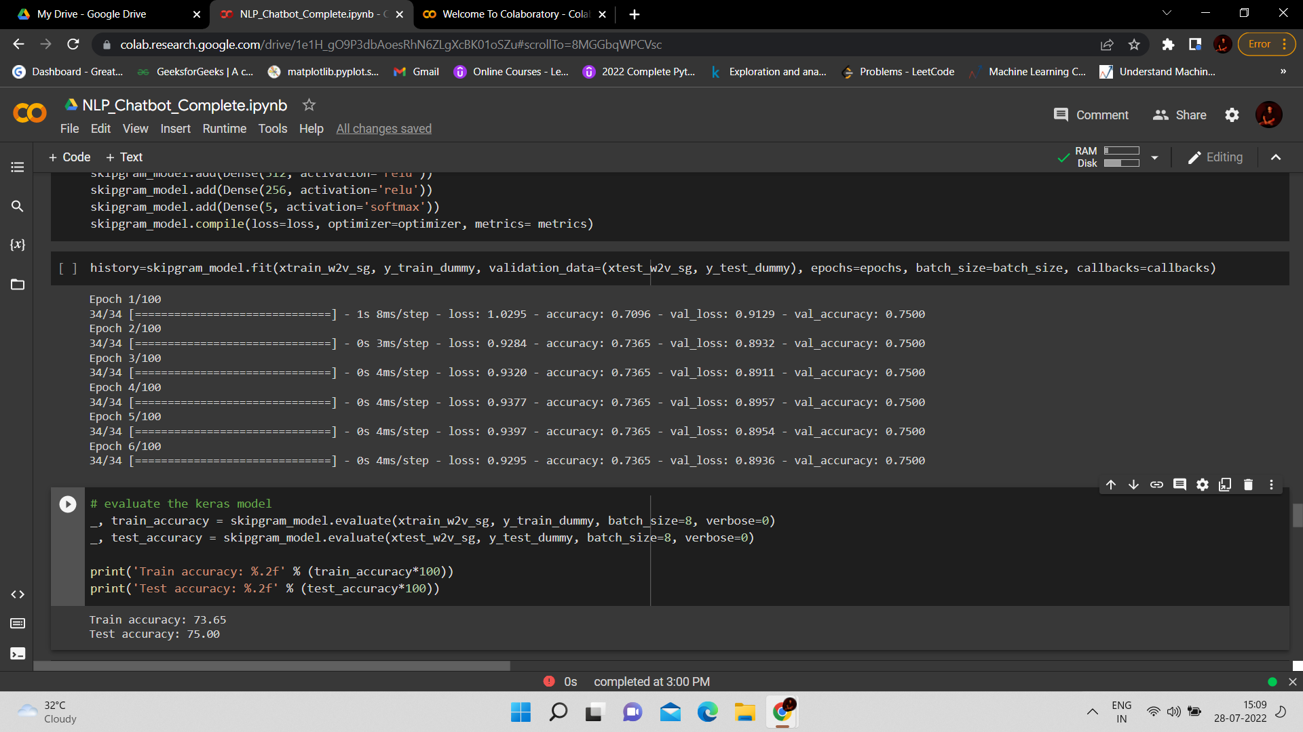
DESIGN AND TRAIN MODEL USING NEURAL NETWORK:
FOR SKIPGRAM :
For First layer :-Relu Activation
For Second Layer : Relu Activation
For Last Layer : Softmax Activation
Accuracy Score
Train – 73.65%
Test - 75%
( SKIPGRAM is similar to Word To VEC )
Model Loss Model Accuracy

Slide 23
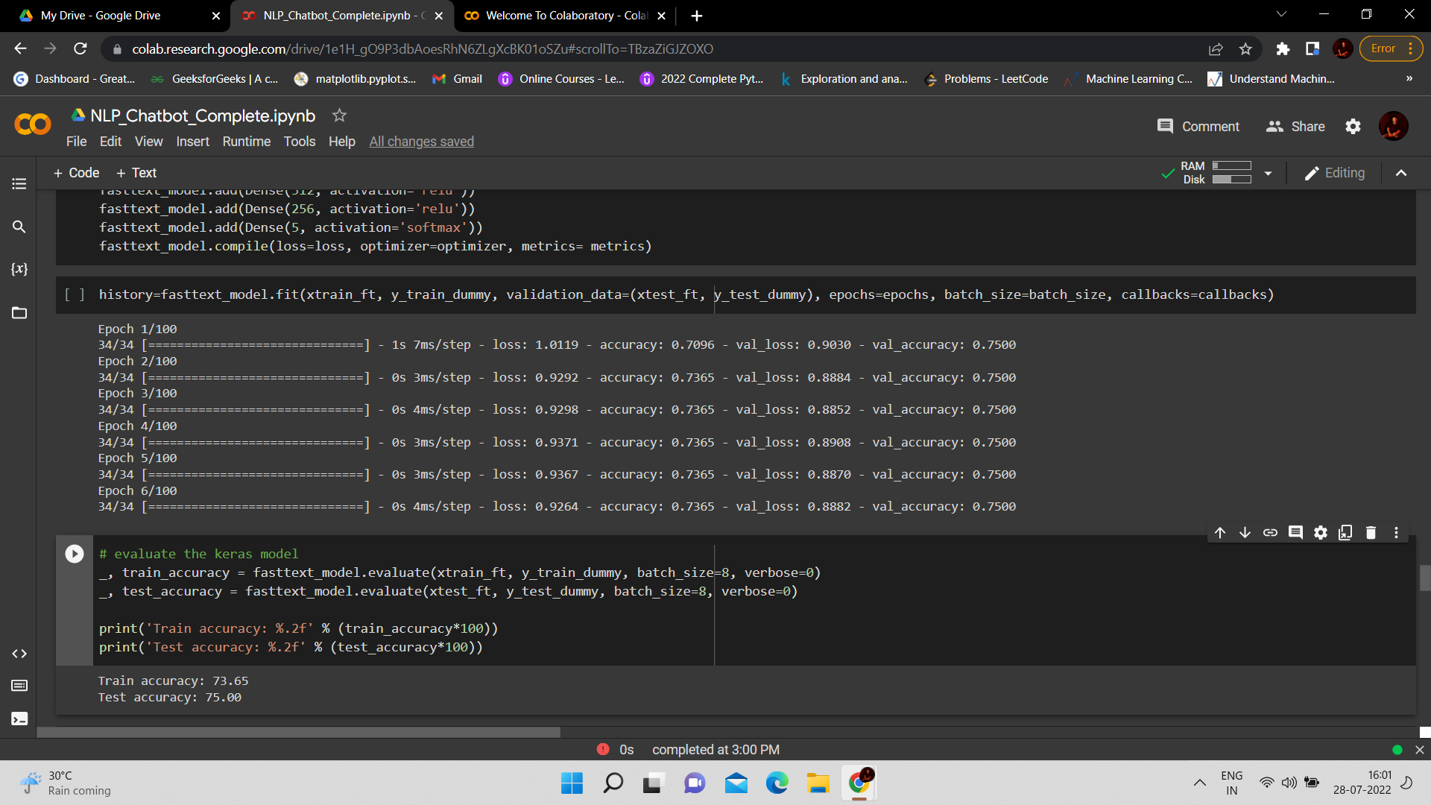
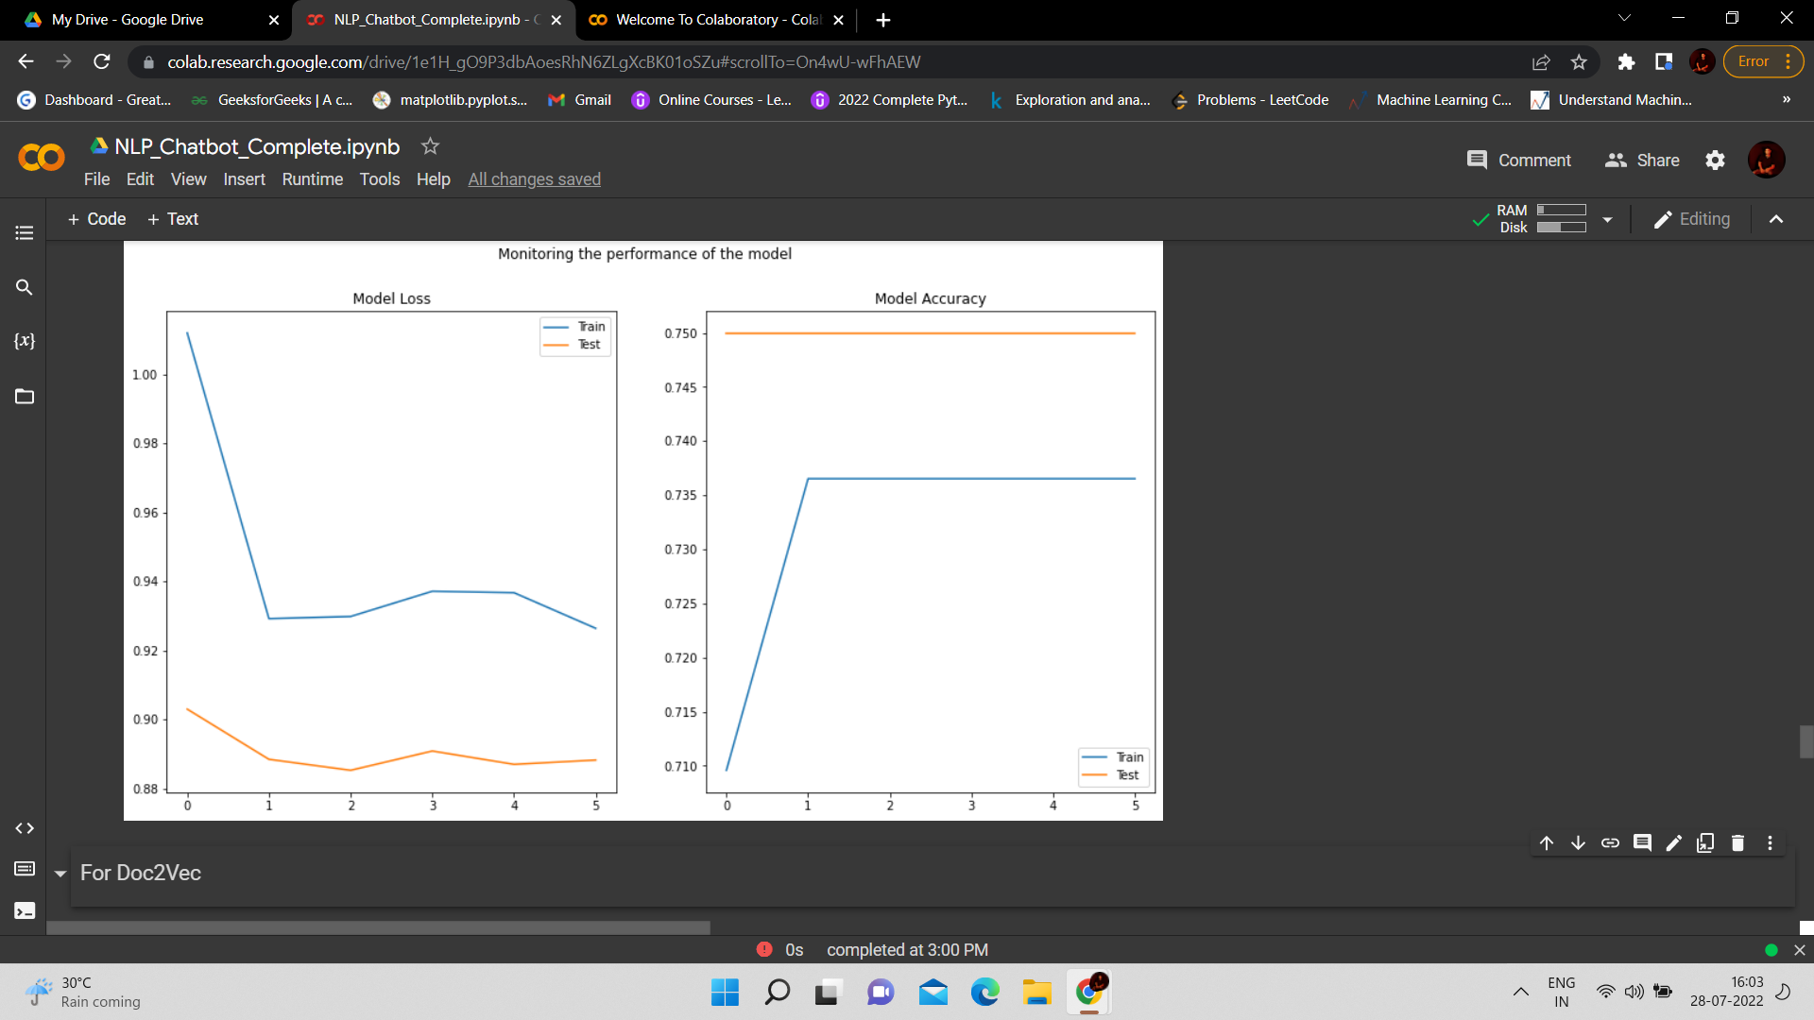
DESIGN AND TRAIN MODEL USING NEURAL NETWORK:
FOR FASTTEXT :
For First layer :-Relu Activation
For Second Layer : Relu Activation
For Last Layer : Softmax Activation
Accuracy Score
Train – 73.65%
Test - 75%
(FASTTEXT is similar to SKIPGRAM)
Model Loss Model Accuracy

Slide 24
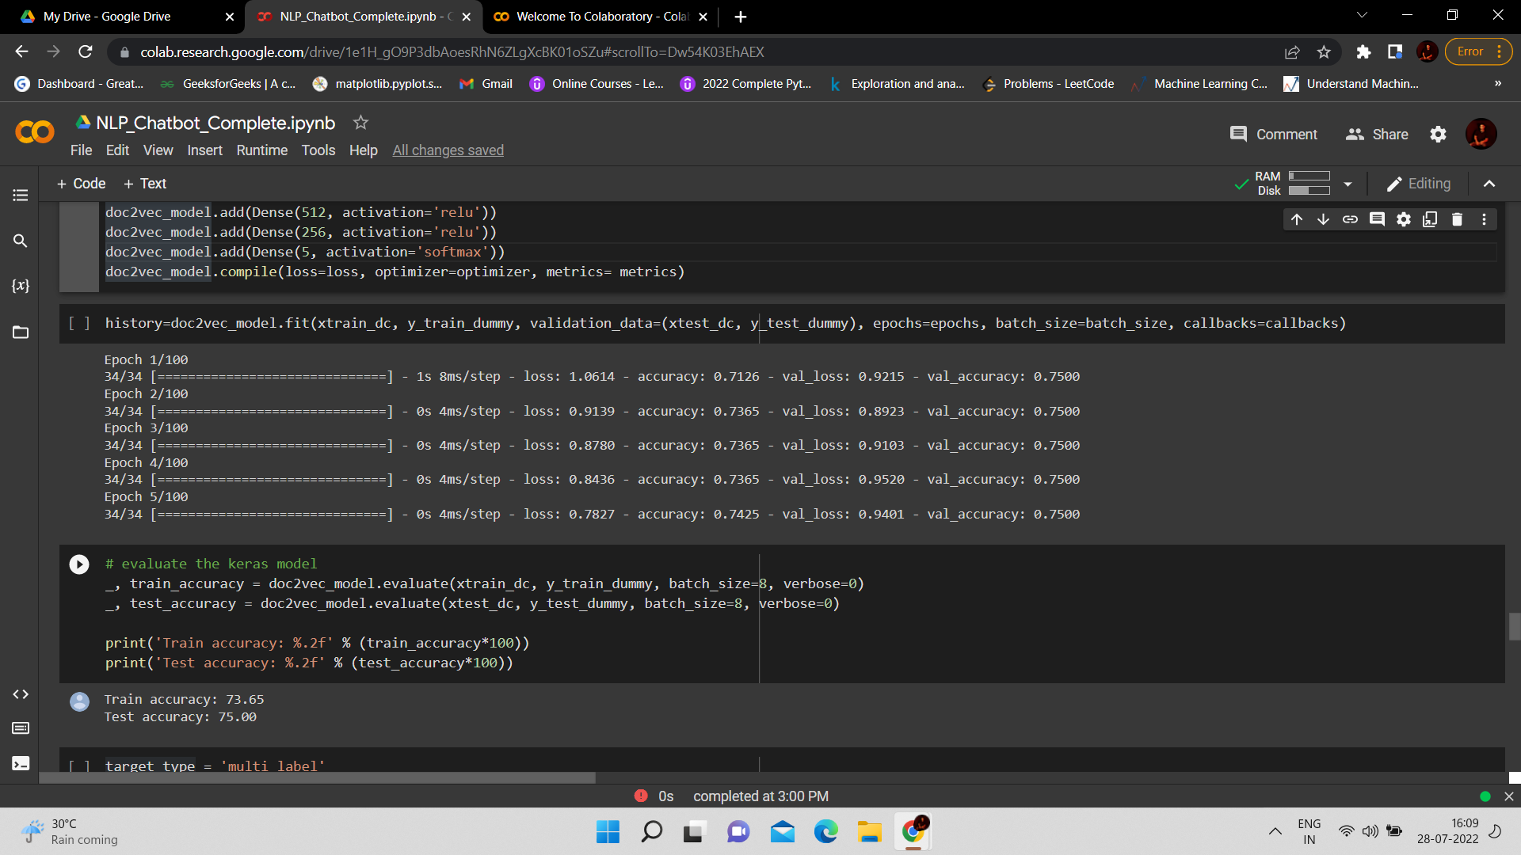
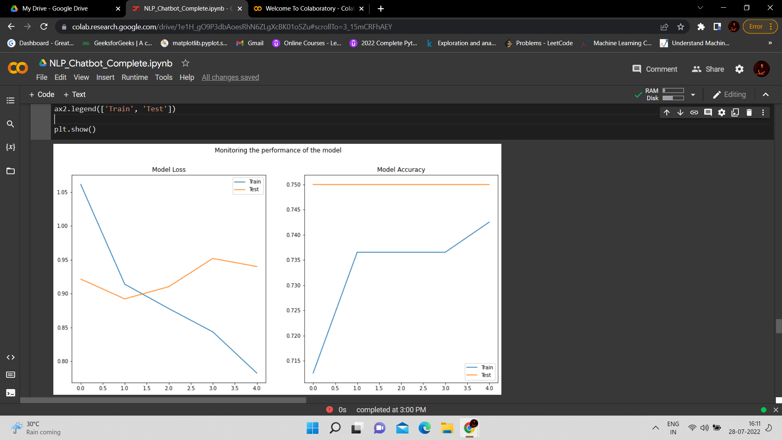
DESIGN AND TRAIN MODEL USING NEURAL NETWORK:
FOR DOC2VEC :
For First layer :-Relu Activation
For Second Layer : Relu Activation
For Last Layer : Softmax Activation
Accuracy Score
Train – 73.65%
Test - 75%
(D0C2VEC is similar to FASTTEXT)
Model Loss Model Accuracy

Slide 25
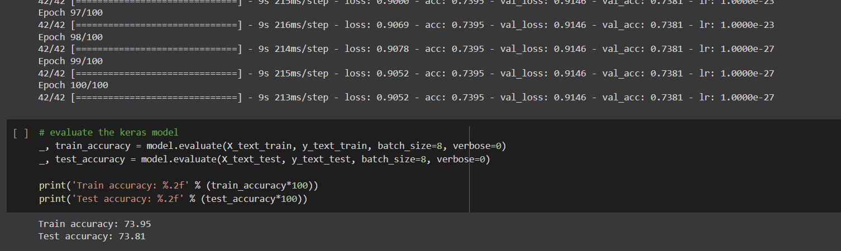
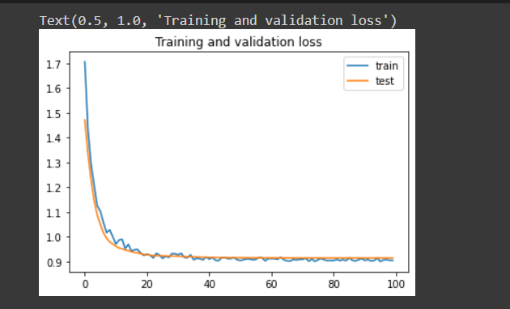
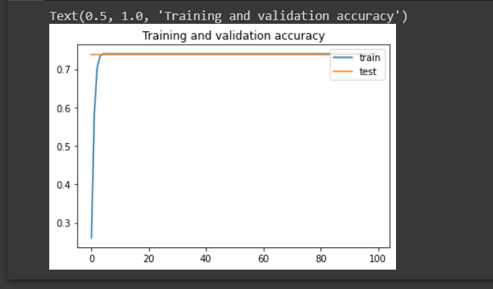
DESIGN AND TRAIN MODEL USING RNN LSTM CLASSIFIER:
FOR GLOVE :
For First layer :-Embedding Layer
For Second layer : Bidirectional LSTM
For Third layer : Global Max Pool
For Fourth layer: Dropout
Accuracy Score
Train – 73.95%
Test – 73.81%
( GLOVE is similar to TF-IDF,
Word To VEC, SKIPGRAM, FASTTEXT
& D0C2VEC)
Model Loss Model Accuracy

Slide 26
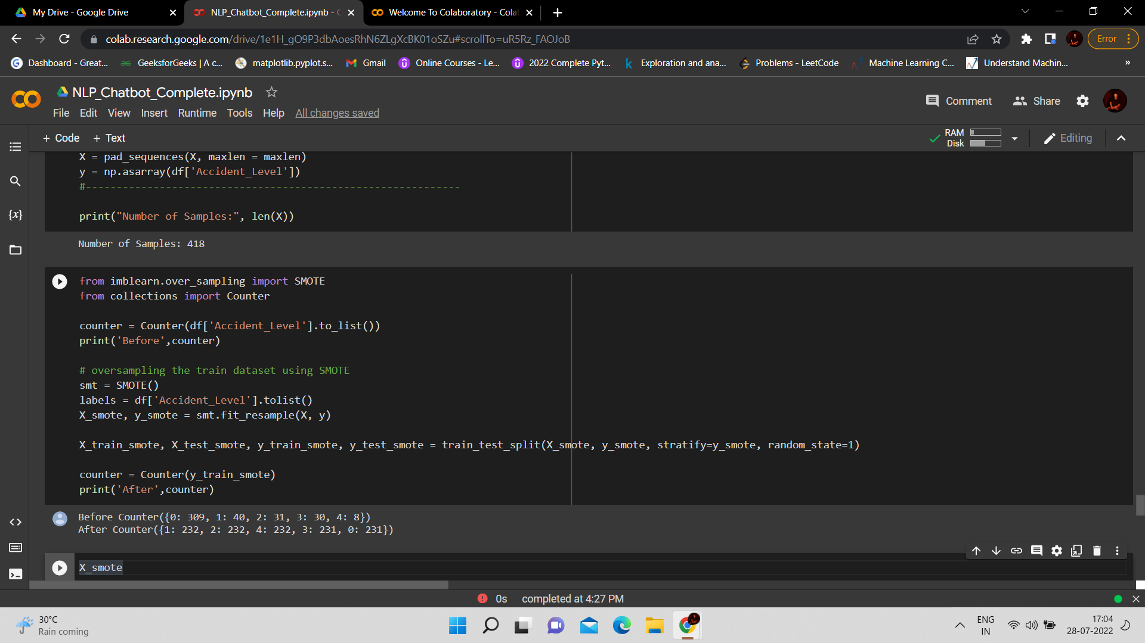
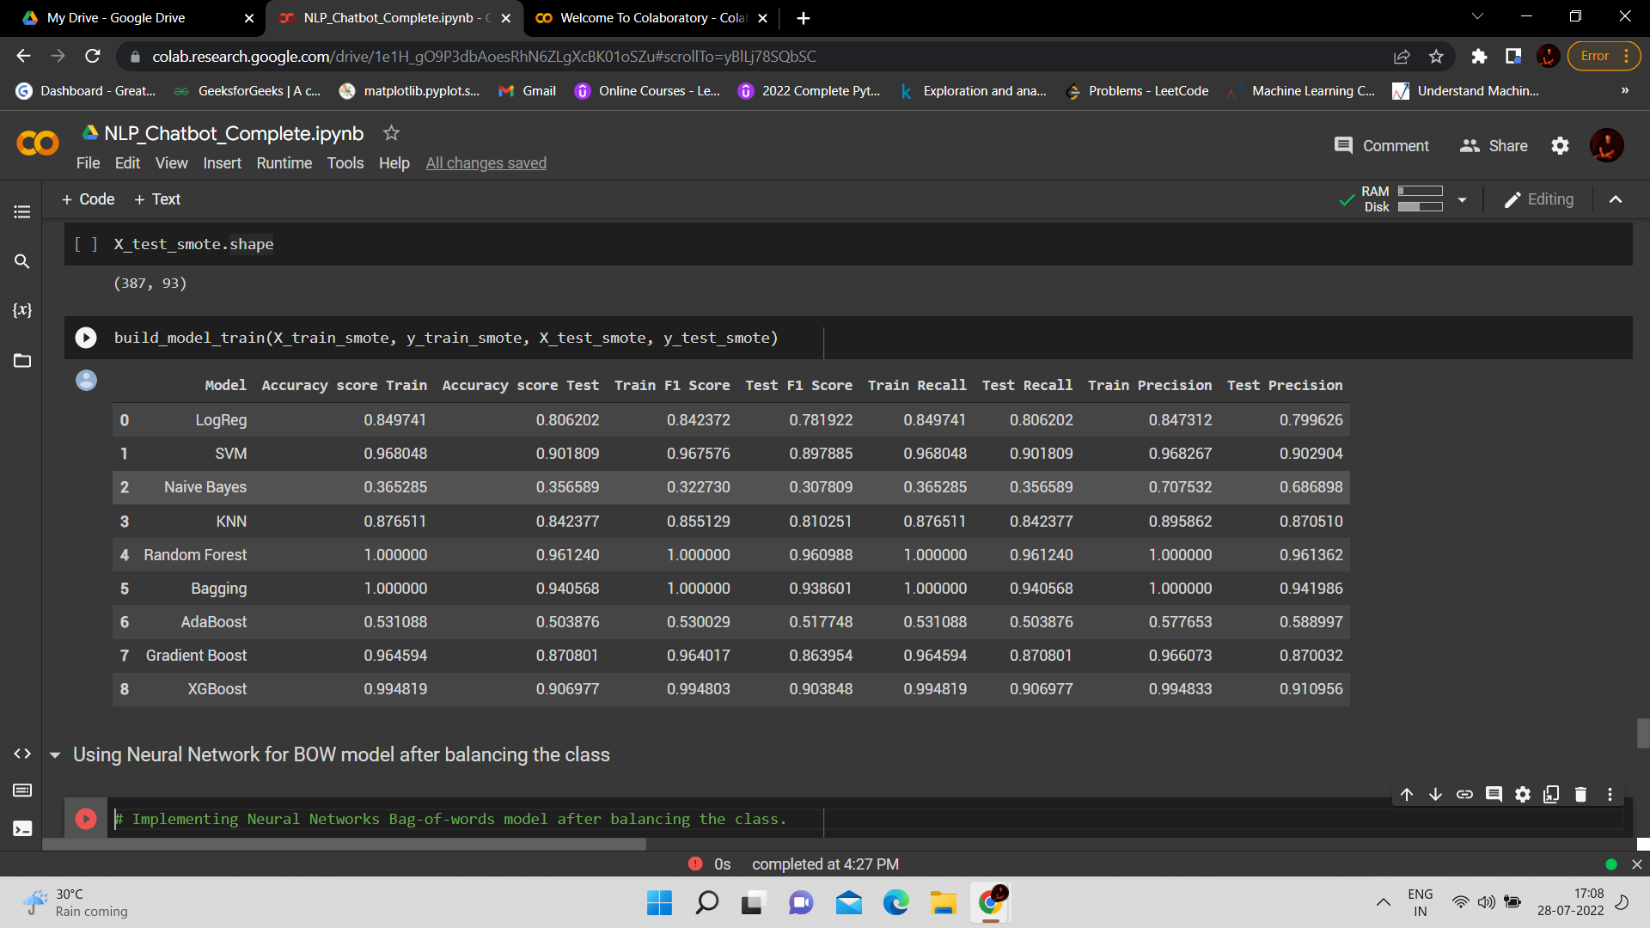
FIXING CLASS IMBALANCE :
USING SMOTE :
X_train shape- 1158 , 93
X_test shape- 387, 93
Accuracy Score OF ML Models
After USing SMOTE.

Slide 27
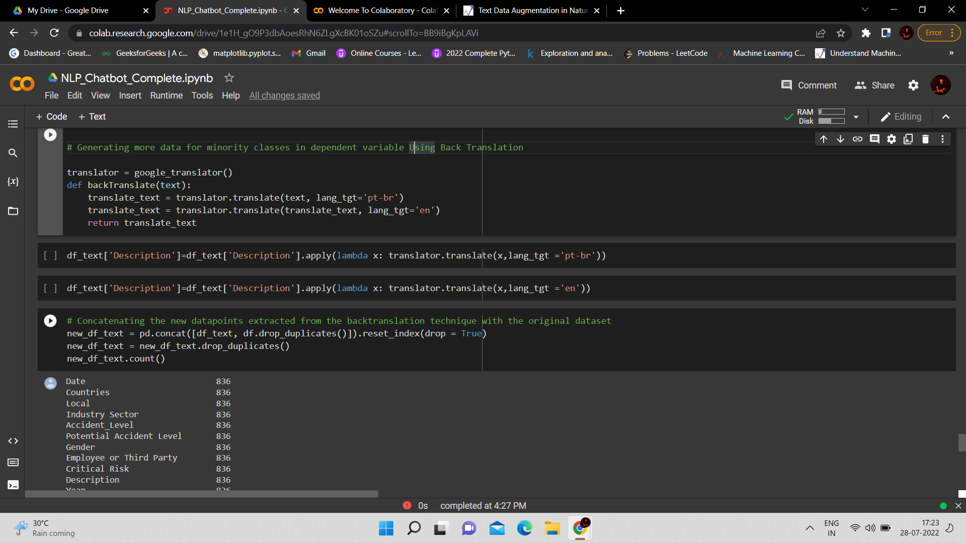
TEXT AUGMENTATION :Data Augmentation (DA) Technique is a process that enables us to artificially increase training data size by generating different versions of real datasets without actually collecting the data. The data needs to be changed to preserve the class categories for better performance in the classification task.
Generating more data for minority classes in dependent variable Using Back Translation :

Slide 28
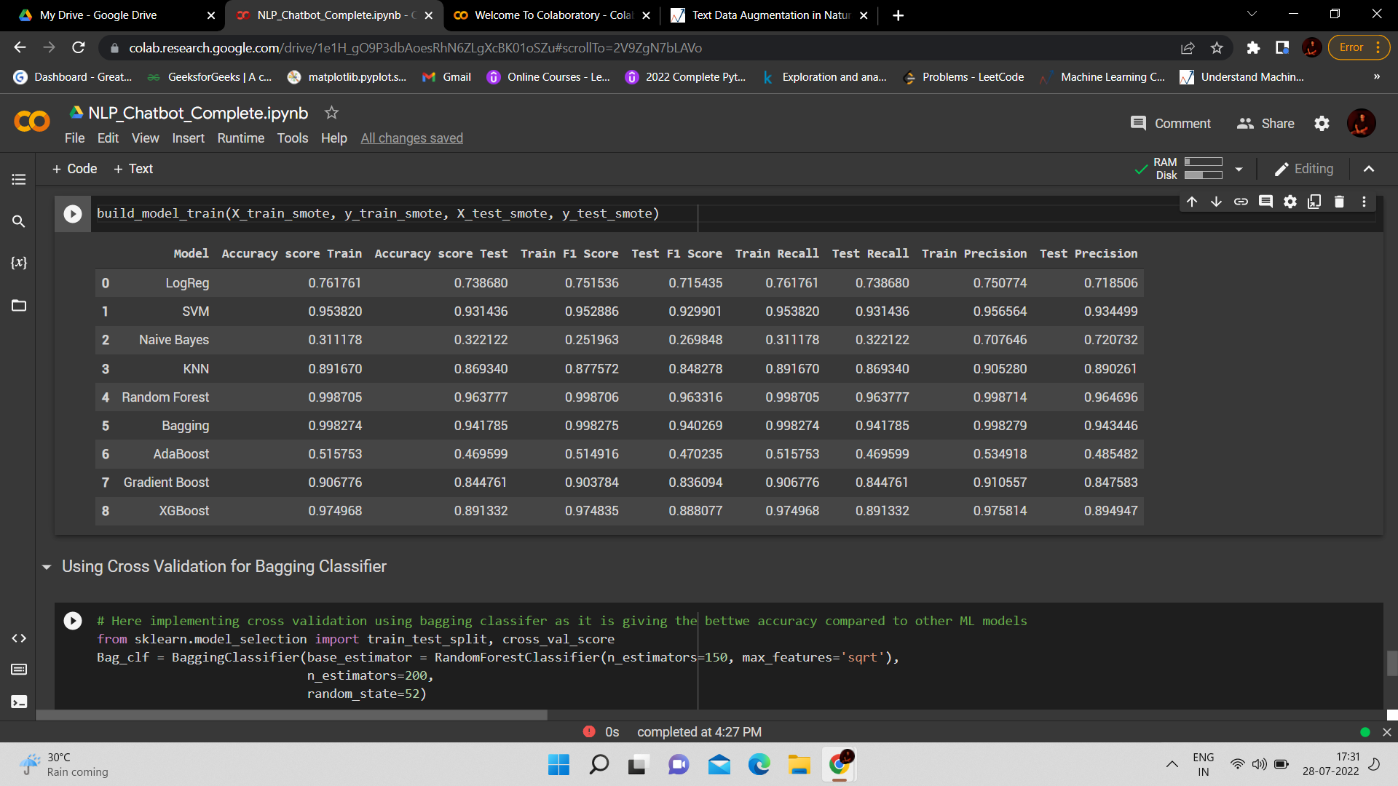
FIXING CLASS IMBALANCE :
USING SMOTE : OVER SAMPLING
Accuracy Score OF ML Models
After USing OVER SAMPLING.
Accuracy has been improved by using SMOTE

Slide 29
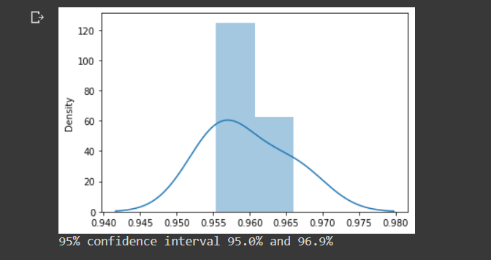
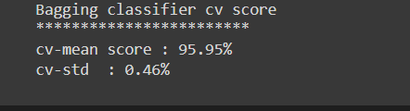
CROSS VALIDATION FOR BAGGING CLASSIFIER :-

Slide 30
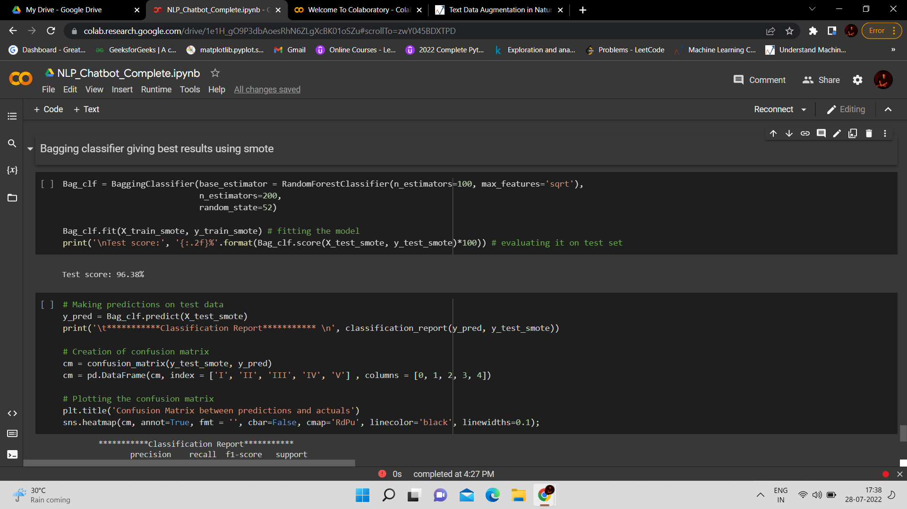
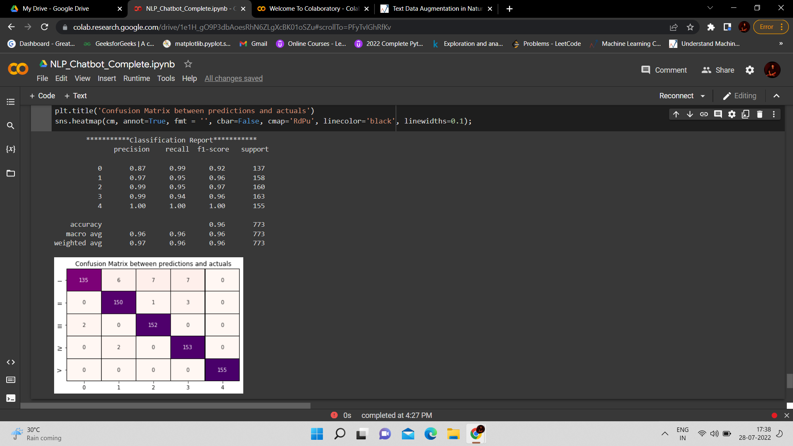
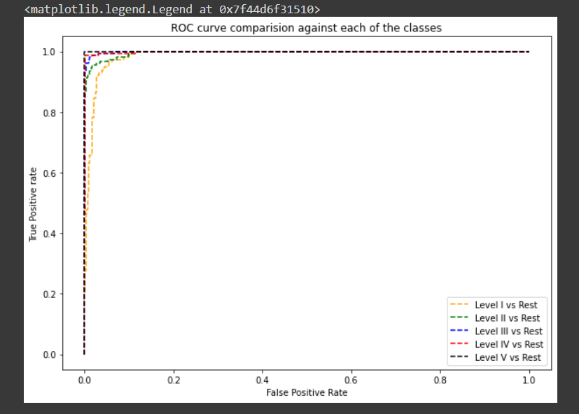
Bagging classifier using SMOTE
Accuracy Score - 96%
CLASSIFICATION REPORT
AUC-ROC Curve

Slide 31
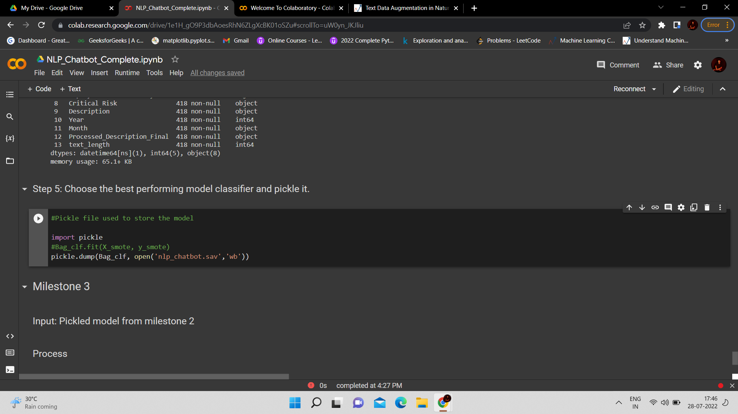
CHOOSE BEST PERFORMING MODEL CLASSIFIER
Bagging Classifier is the best model .
Bagging Classifier with SMOTE is best.
The Accuracy is best of this .

Slide 32
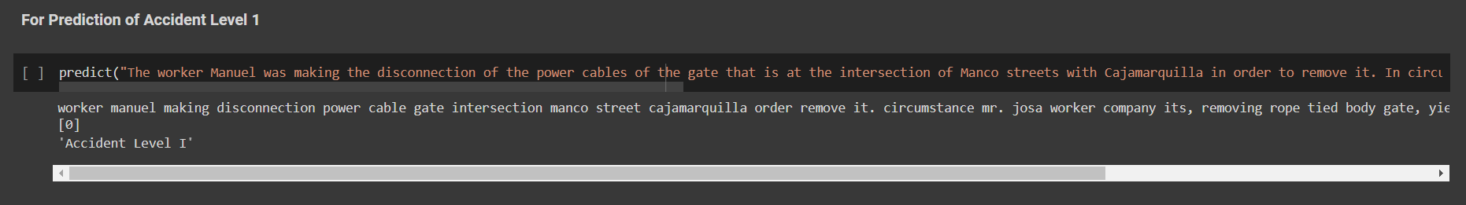
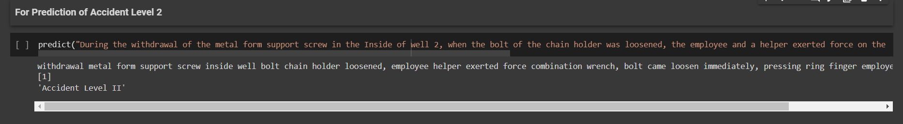
PREDICTIONS FOR DIFFERENT ACCIDENT LEVELS
ACCIDENT LEVEL 1
ACCIDENT LEVEL 2

Slide 33
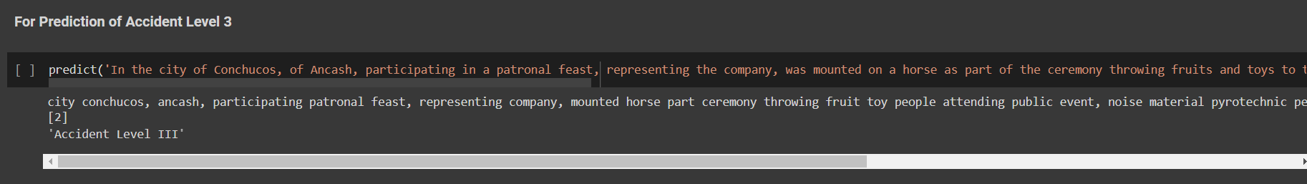


ACCIDENT LEVEL 3
ACCIDENT LEVEL 4
ACCIDENT LEVEL 5

Slide 34


UI INTERFACES OF CHATBOT

Slide 35



